Slide 1
Interregional Youth Policy Forum
21-23 November 2017
Bangkok
Feedback from project partners, learning from each other
  Sierra Leone Perspective
  Ngolo Katta - National Consultant
  Executive Director
  Centre for Coordination of Youth Activities - CCYA

Slide 2
Interregional Youth Policy Forum
21-23 November 2017
Bangkok
Main findings of the 2014 Labor Force Survey Report
“Informal is normal”: most of the Sierra Leonean population is employed in informal jobs in the agriculture and household enterprise sectors – a jobs agenda aimed at improving living standards needs to focus on “better employment” in these sectors to immediately tackle the job challenges faced by the country
Financial constraints, access to inputs and a low skilled workforce limit productivity and represent a barrier to the creation of good jobs in all the economic sectors
    Removing these constraints is imperative for the expansion of the wage sector in the long term
Youth, women and residents in rural areas face higher barriers to “quality jobs”:
    Societal expectations and early family formation limit employment and earning opportunities for women, typically concentrated in the household enterprise sector.
    Low skills level and financial constraints results in difficulties for the youth in finding jobs in the formal sector
    Limited knowledge of modern agricultural practices as well as low access to inputs and capital represent severe challenges for those living in rural areas.

Slide 3
Interregional Youth Policy Forum
21-23 November 2017
Bangkok
Most have jobs, especially in rural areas where majority cannot “afford” not to work
Employed (%) Employment by Economic Sector (%)
There are no gender differences in likelihood of being employed
Youth less likely to be employed
The agriculture and services sectors employ the vast majority of workers

Slide 4
Interregional Youth Policy Forum
21-23 November 2017
Bangkok
Desk Review
National youth Commission 2009
National Youth Employment Action Plan: 2012 - 2016 in Sierra Leone
Revised National youth Policy 2012
National Youth Development Blue Print
National Youth Service Corp Act 14
Identifying Youth Organizations working on youth employment issues
Notes:
Visitation and Consultations with Institutions promoting Youth skills training and employment Programmes. YMCA

Slide 5


Interregional Youth Policy Forum
21-23 November 2017
Bangkok
Notes:
Visitation and consultation with Youth Skills Development and Employment Organizations YMCA – Queen Leaders Project

Slide 6

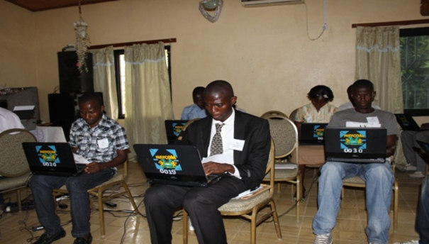
Interregional Youth Policy Forum
21-23 November 2017
Bangkok
Notes:
Visitation and Consultation with National Youth Commission on Graduate Internship Project GIP

Slide 7
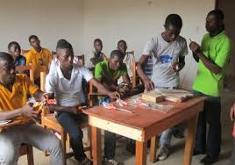
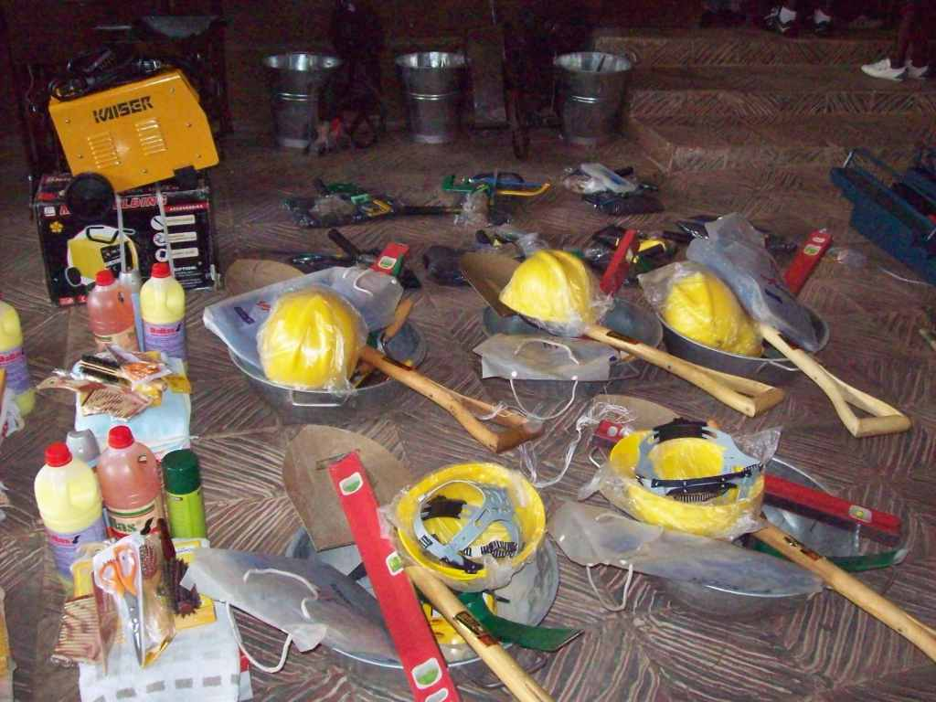
Interregional Youth Policy Forum
21-23 November 2017
Bangkok
Notes:
Visitation and consultation with Youth Skills Development and Employment Organizations YMCA – Slum Dwellers Project

Slide 8
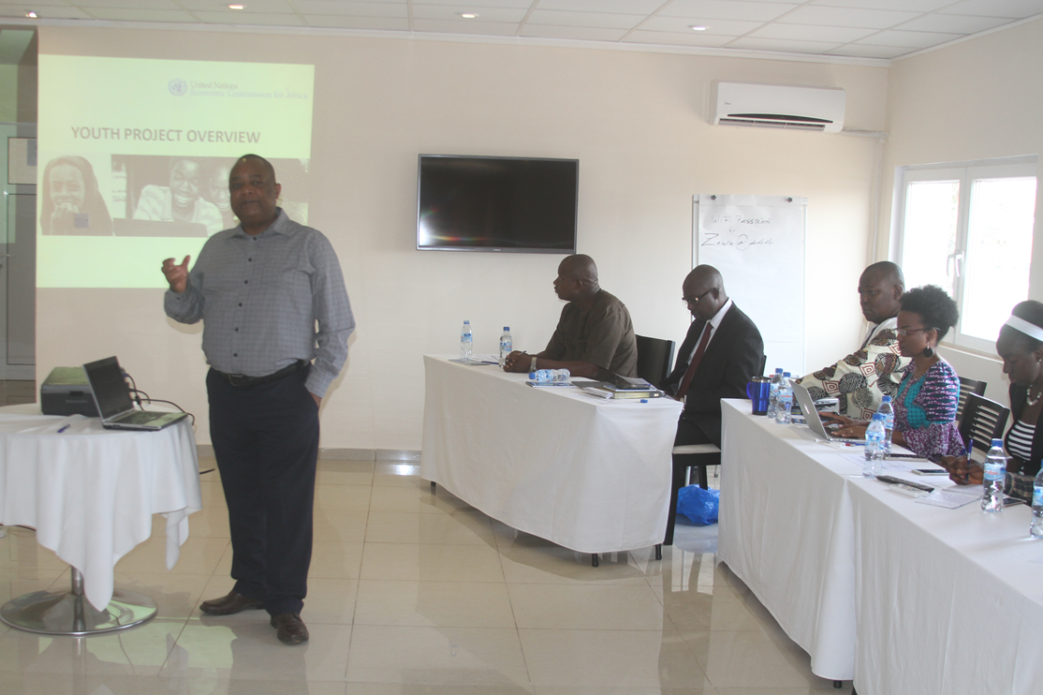
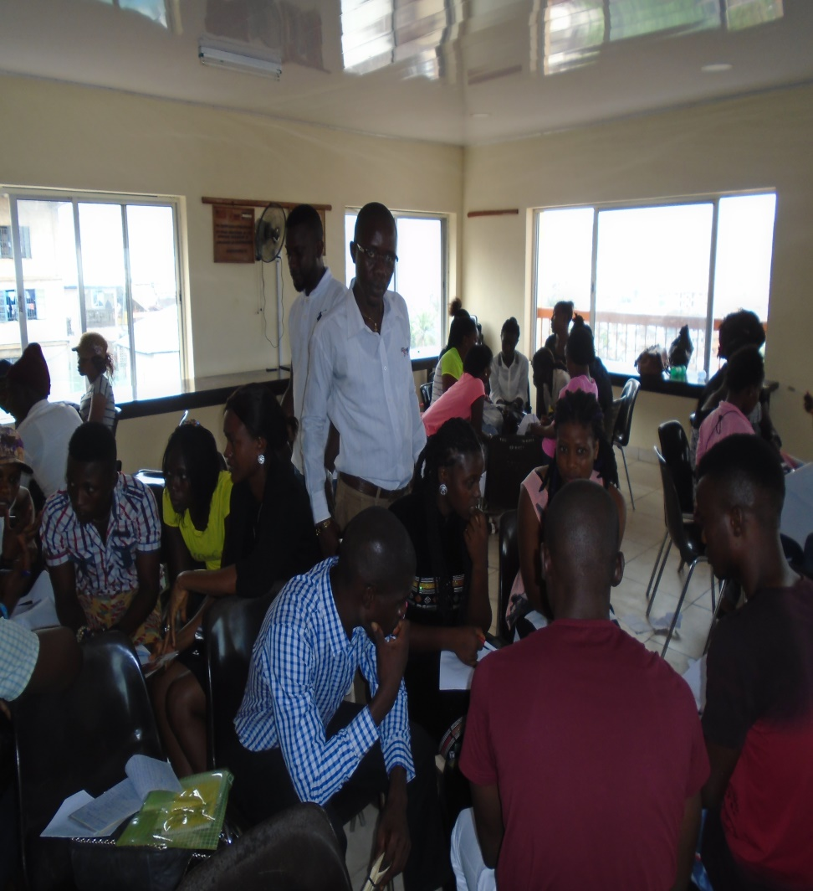
Interregional Youth Policy Forum
21-23 November 2017
Bangkok
Notes:
National Validation Workshop of Youth Policy Toolbox 22nd-23rd February, 2017 bring various Youth institution and Ministry of Youth Affairs and National Youth Commission- Rationale, expected accomplishments and Strategic partnerships.

Slide 9
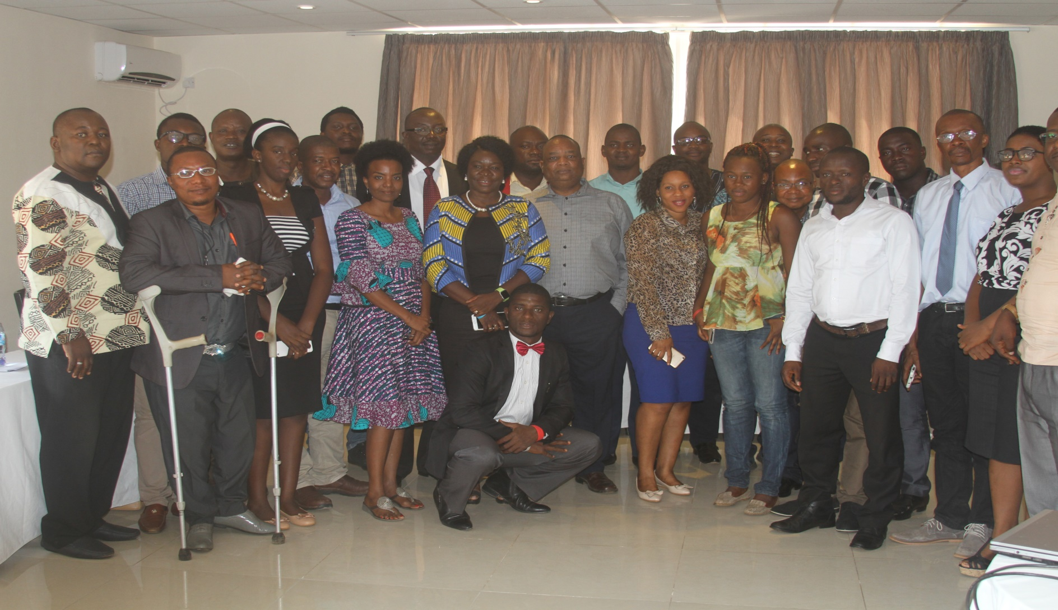
Interregional Youth Policy Forum
21-23 November 2017
Bangkok
Notes:
National Validation Workshop of Youth Policy Toolbox 22nd-23rd February, 2017 bring various Youth institution and Ministry of Youth Affairs and National Youth Commission

