Slide 1
The Toolbox development journey
Conceive
Develop
Test
Refine

Slide 2
Conceive
Member State demand driven
Interregional discussion
ICT and Innovation
Online platform
Multi-functional
Large audience
Vast distances

Slide 3
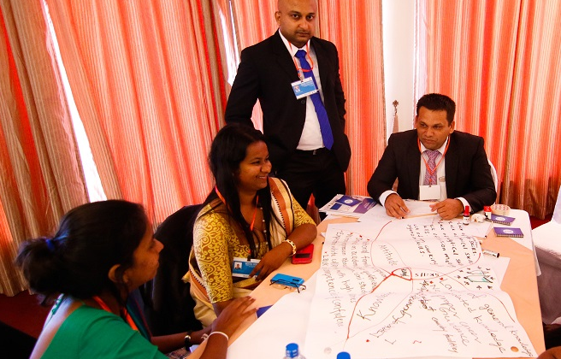
Develop
Partnership
Consultations
Pilot website
***Committed to a continuous development process***

Slide 4
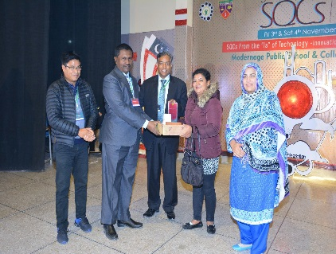
Test
Mongolia
Sri Lanka
Additional partnership in Pakistan gained
The Philippines
Notes:
Two levels of testing:
A deep level with select national partners
A broader level with a variety of audiences at relevant workshops and meetings
At the national level, partners not only helped test the Toolbox during national workshops, they also generated a lot of the content that is now featured on the Toolbox

Slide 5
Test
Testing the pilot platform
Compiling feedback
Deeping our knowledge base
Gathering inputs from national stakeholders
Interviews
Training modules
Policy analysis
Capacity building
Notes:
Testing the pilot platform
Compiling feedback
Deeping our knowledge base
Learning about the situation of youth in different contexts across the region
Collecting good practices
Reverse engineering successful outcomes
Make the knowledge more easily replicable
Gathering inputs from national stakeholders
Interviews
Training modules
Ownership
Policy analysis
Capacity building

Slide 6
Test
AUYA
SEWF
DESA & Commonwealth
MIYD
Notes:
Additional outreach
AUYA
Malacca
SEWF
UNDP in Bangkok (Universities one)
Check list for all events presented at

Slide 7
Refine
Based on the feedback in the test phase
From Africa and Western Asia
Adjust and fine-tune the Toolbox
Optimize the user experience
Additional content

Slide 8
YOUTH POLICY TOOLBOX
DEVELOPMENT
JOURNEY
JACINTA HARFORD

Slide 9
I was lucky enough to work on the Youth Policy Toolbox in Ulaanbaatar with the Mongolian project partners.
ABOUT ME
Notes:
The first time I was brought into the project was when we met Kal.
We will talk about the mechanisms and modalities involved in creating the toolbox.
Experience as a project partner and as ESCAP team.
Invite discussion for the participants to talk about their experience
and ideas ideas.
Start strong, finish strong!
Make simple and memorable.
Similar experiences with the other coutnries. Used a similar process in all three of the other countries. What it was like to be one of the partners. Although I am going to speak about Mongolia and experience there, similar thing done in Sri Lanka and the Phillipines.
Also, I only did a small part of the project, mostly helping to collect best practices and editing. The Mongolian team did a lot of work in preparation for this. As you will hear from the representatives Bolortsetseg Sosorburam tomorrow, who is head of foreign relations for the Authority for Family, Child and Youth Development, Mongolia.
Although I am going to talk about Mongolia, I know, from working on this side of the project, a similar process was undertaken in all the other project countries.

Slide 10
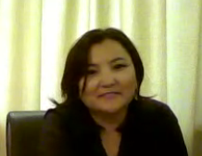
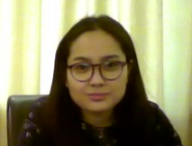
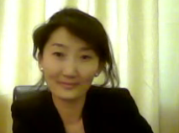
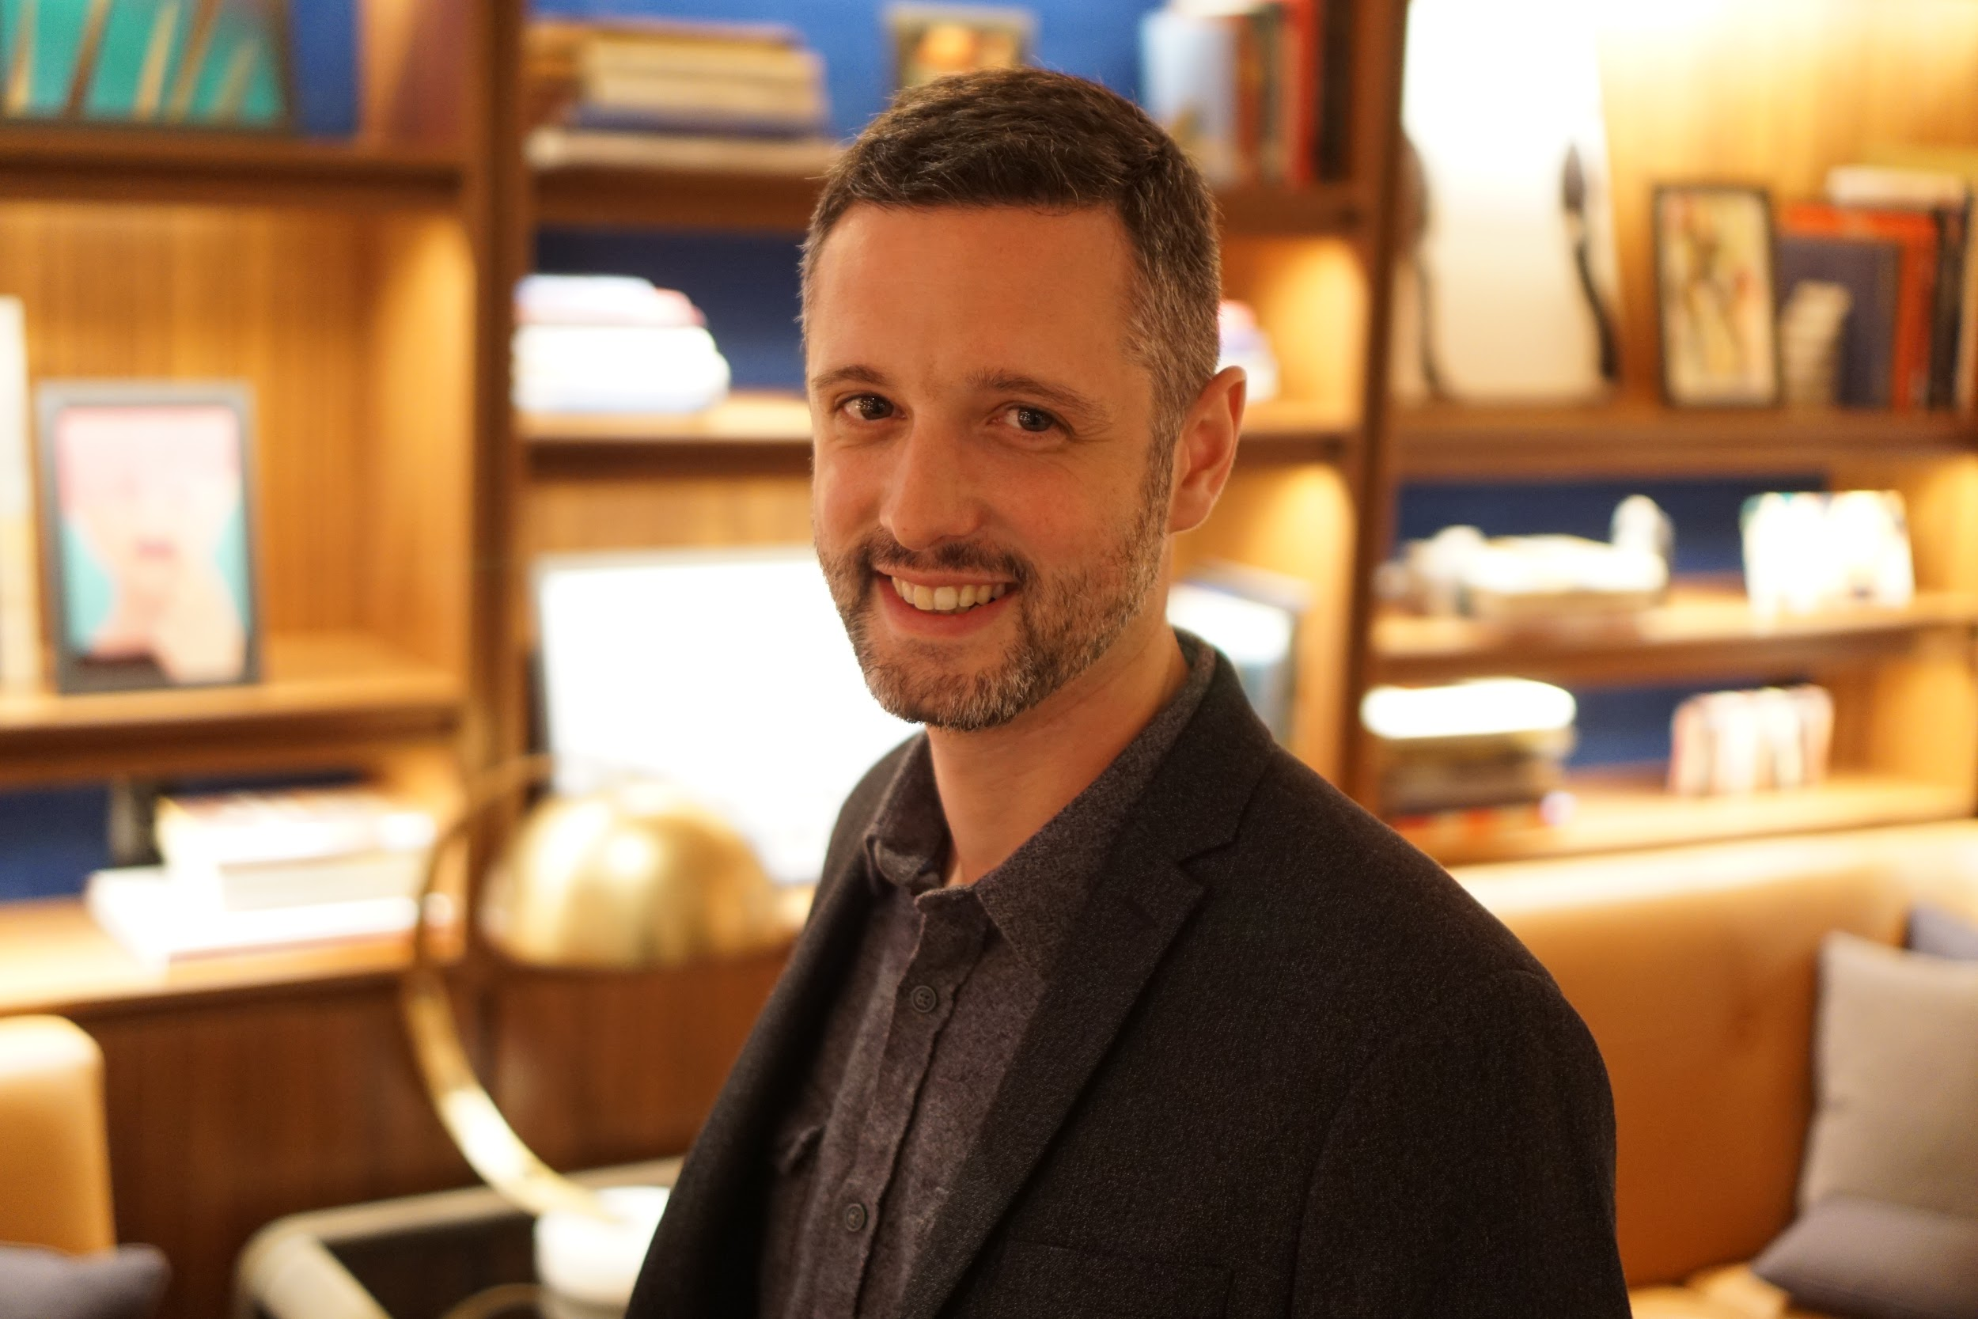
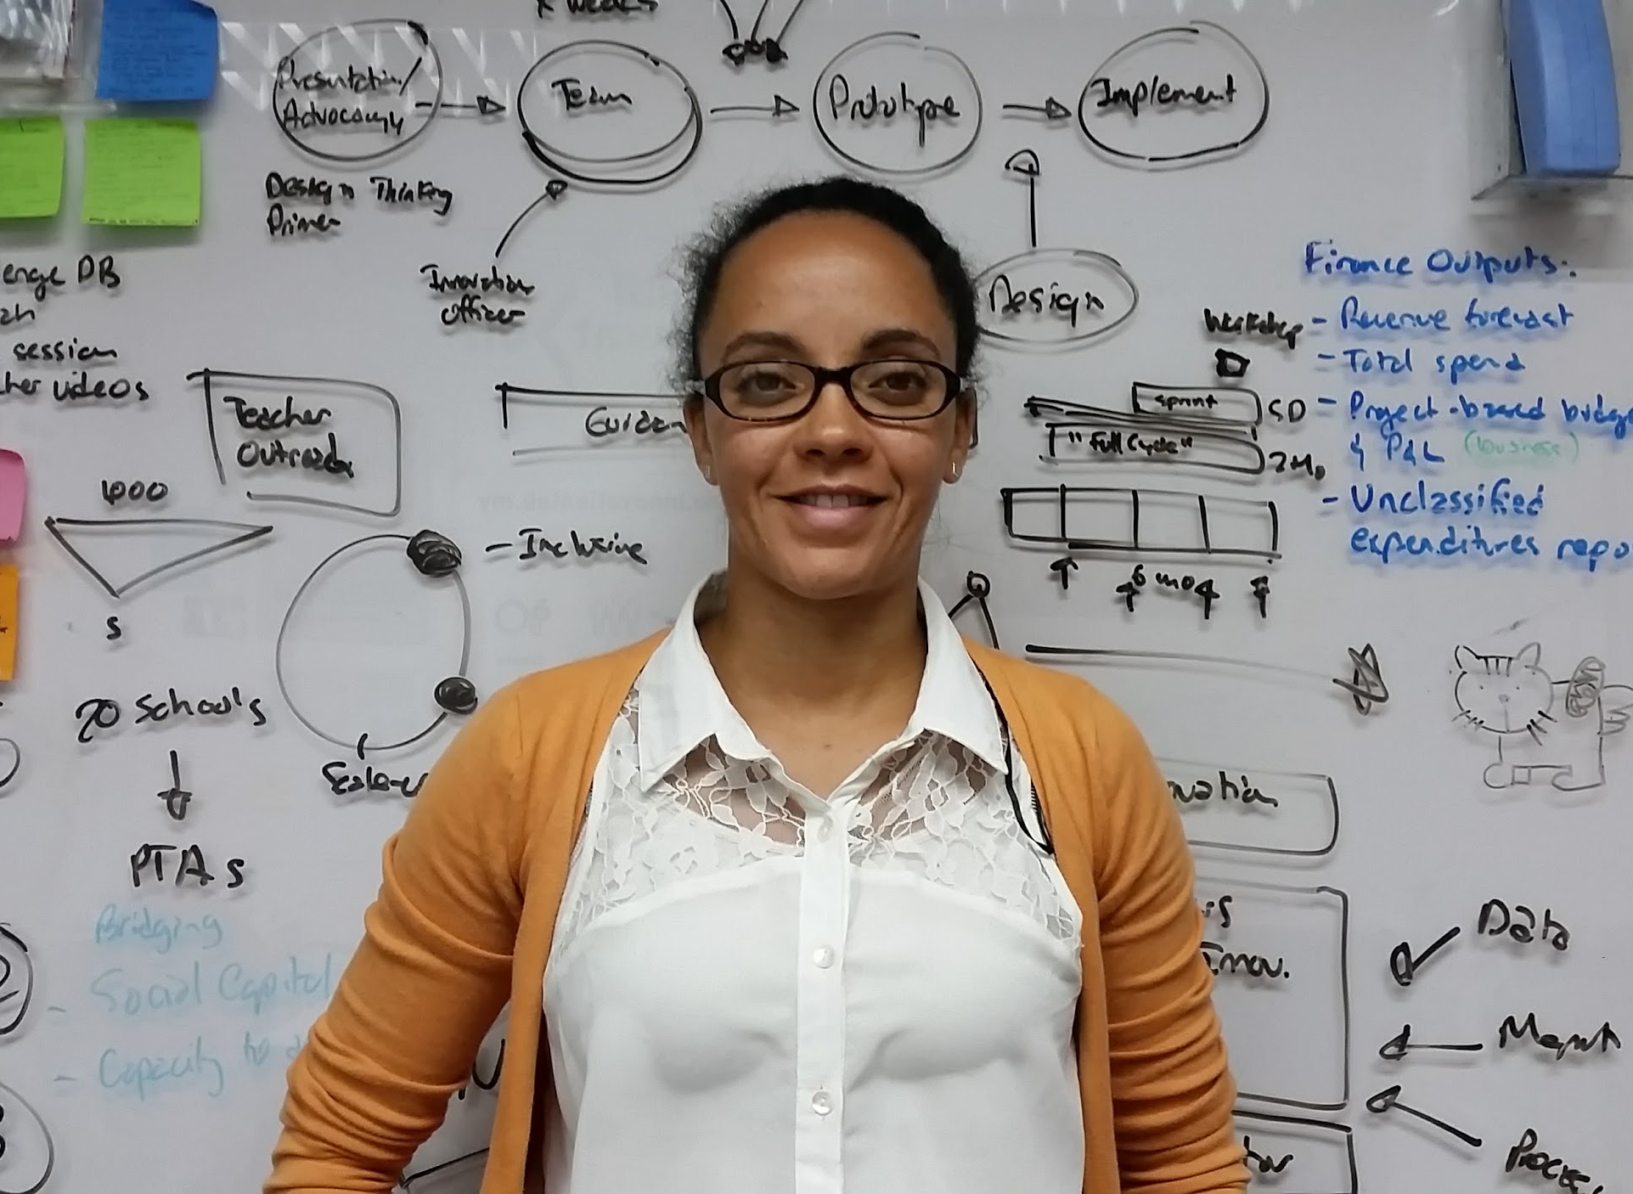
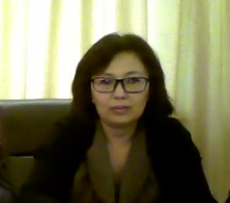
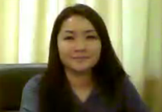
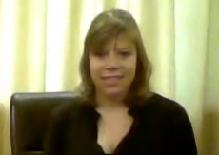
THE TEAM
Ariuntsetseg
Program director,
Center for Citizenship Education
Favourite dessert: chocolate
Shijirtuya Munkhbat
Member of working group,
Mongolian Youth Council
Favourite dessert: chocolate
Bolortsetseg
Foreign relations officer B
Favourite dessert: cheese cake
Kal Joffres - Tandemic
Favourite dessert:
Tiramisu
Dr. Emma Rhule - Tandemic
Favourite dessert:
Lemon pie
Khongorzul
Head of foreign relations,
Mongolian Youth Federation
Favourite dessert: strawberry ice cream
Khulan
Officer of Youth development department
Favourite dessert: chocolate
Jacinta Harford
Australian volunteer at Authority for Family Children and Youth (AFCYD)
Favourite dessert: apple crumble
Notes:
My favourite desert is still apple crumble, Bolortsetseg (Boggie) favourite dessert is cheese cake and this is apt because she baked the most delicious cheesecake and brought it inot the office. Best thing on a freezing cold day witha coffee.
Half of these people speak English and half don’t. For some reason we are all wearing black on that day.
The journey started for me when we met Kal from Tandemic.
This concept of conducting small scale experiments to see what the problems really are for youth and policymakers was unheard of amongst our team.
We did some brainstorming and thought of a few reasons the toolbox may not work in

Slide 11
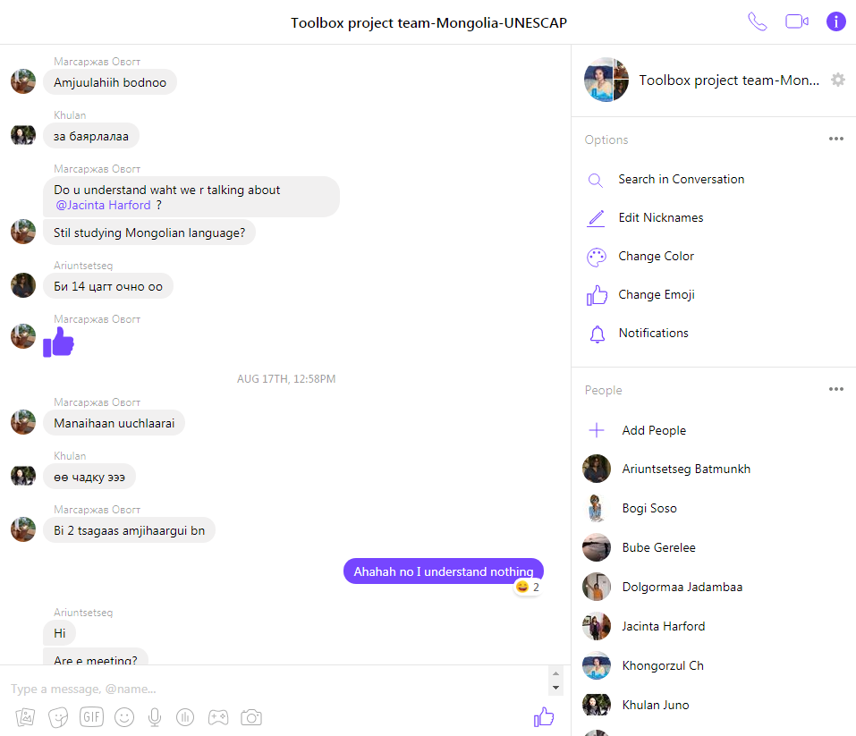
“No, I understand nothing”
CHALLENGES
Notes:
(Discussion on the experience of participants in creating similar platforms and envisioning future developments)
Challenge is switching back and forth between English and Mongolian.
Difficulties with translation at the meeting.
Problem - Communicating between myself, Boggie, Khulan, and the team.
Photo of the conversation in Mongolian.
Solution - Well it was the work of the Mongolian team members who translated.
Takeaway - should be enhanced

Slide 12
OUR INSIGHT
Together, we did some brainstorming and thought of a few reasons the toolbox may not work in Mongolia.
Notes:
Start strong, finish strong!
Make simple and memorable.
Similar experiences with the other coutnries. Used a similar process in all three of the other countries. What it was like to be one of the partners. Although I am going to speak about Mongolia and experience there, similar thing done in Sri Lanka and the Phillipines.
Content is not practical for policymakers because it does not consider available resources
Content is not practical Youth NGOs because it does not consider available resources
In rural areas, public servants not interested in the content/issues
Hard to coordinate messaging between youth organisations & policymakers

Slide 13
OUR JOURNEY
The process of creating content led the team to talk to youth and policymakers in rural areas.
Notes:
When first brainstorming about the problems, it was hypothesized that policymakers in the countryside were not interested.
Through the experiments we found out this was not true.
They are not only interested and but perhaps overlooked because it is assumed they are not interested.

Slide 14
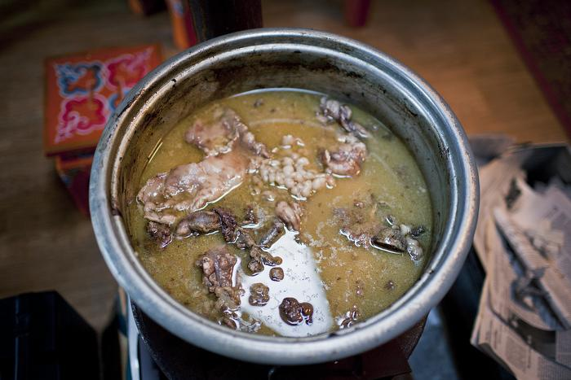
Ulaanbaatar Soup
OUR JOURNEY
Ulaanbaatar Soup is a youth entrepreneurship initiative implemented by the Mongolian Youth Council.
Notes:
Ulaanbaatar Soup (UB Soup) is a youth entrepreneurship initiative implemented by the Mongolian Youth Council.
People get together and enjoy a meal, participants then present on his or her project.
Audience members vote on which project benefits society most.
Project with the most votes receives all of the funds from meals sales

Slide 15
OUR JOURNEY
In the pursuit of best practices the Mongolian Youth Council did an evaluation of their project.
Notes:
One of the team members: Shijirtuya
Between 2016 and 2018, UB Soup plans to create an online platform that includes additional funding opportunities, expands the scope of the events and promotes sustainable cooperation between the private sector and the Government.
Surveys were done to
Tease out why did it succeed? Get funding etc. Actually looked at how well did it work? Before trying to find best practices. There were surveys done by Shijirtuya and the organisers looked at whether their inititiative was working.This had not been done before.
From the evaluations they decided to create an online platform.
Between 2016 and 2018, UB Soup plans to create an online platform that includes additional funding opportunities, expands the scope of the events and promotes sustainable cooperation between the private sector and the
hus far, UB Soup events have given youth the chance to pitch 17 different projects with more than 150 people in attendance and raised $US 700 which went directly to community projects. Three winners have started a nonprofit organization, a project against violence and an art movement. Among these includes, “Ivolunteer” that is now the biggest platform for volunteers to get opportunities in Mongolia. The aforementioned art movement uses public mosaics to convey social messages such as water conservation. With the support of the Mongolian Youth Council these projects are thriving, largely in part to their collaboration of the Government, private sector and youth NGOsGovernment.
The process of content creation led to the enhancement of this specific youth led organisation.

Slide 16
OUR JOURNEY
When looking around for content we reached out to another NGO who worked in the same building….
Notes:
Photo by Sanetwo Tnmc on Unsplash.
GIZ are working on a project on TVET

Slide 17
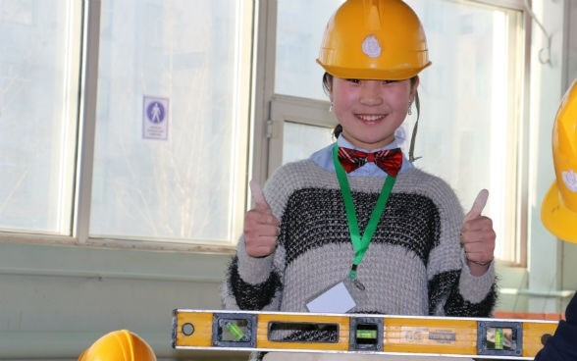
And we wrote a best practice about their TVET project.
Notes:
TVET! commissioned by the German Federal Ministry for Economic Cooperation and Development (BMZ).
Since March 2013 the “Cooperative Vocational Training in the Mineral Resource Sector” (CVT) project has been supporting the Ministry of Labour and Social Protection (MLSP) and selected vocational training facilities in Mongolia to improve formal, technical vocational training and in establish a cooperative approach between the state, the private sector and civil society.
A co-financing arrangement by the Swiss Agency for Development and Cooperation (SDC) makes it possible to extend the action areas to include short-term training and career guidance measures and to expand the project geographically. Additional co-financing by the Australian Government’s Department of Foreign Affairs and Trade (DFAT) supports activities in South Gobi province, including a partnership with an Australian Technical and Further Education (TAFE) Institution. The project is commissioned by the German Federal Ministry for Economic Cooperation and Development (BMZ).

Slide 19
The team then worked together to produce the training modules for the toolbox
Notes:
We worked in the same building and finally got together to pursue the cause. The training modules they created were on project management - which youth and policymakers indicated they would find valuable when we surveyed them at the national workshop.

Slide 20
Notes:
Part of the training module that GIZ then created.

Slide 21
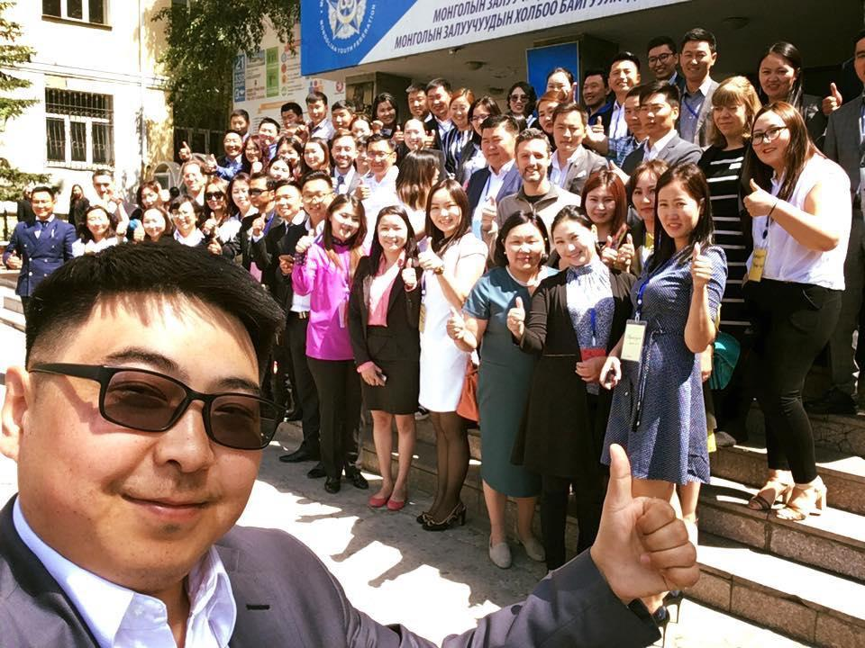
The team learnt a lot from organising the National Workshop
OUR JOURNEY

Slide 22
And the project is made more sustainable by the knowledge gained from the National Workshops

Slide 23
Thank you to all the people who have come together to create a tool that aims to make the lives of youth better.
CONCLUSION
Notes:
All these people coming together to create a site that makes the lives of youth in each individual country better.

