Slide 1
THE ROLE OF ICTs IN ENHANCING YOUTH EMPLOYMENT

Slide 2
- in 2005 Tunisia held the second phase of The World Summit of Information Society (WSIS) organized by International Telecommunications Organisation.
United Nations Group on the Information Society (UNGIS), consisting of the relevant UN organizations with the mandate to facilitate the implementation of the WSIS outcomes.

Slide 3
The WSIS Action Lines to reduce the digital divide:
C1. The role of public governance authorities and all stakeholders in the promotion of ICTs for development
C2. Information and communication infrastructure
C3. Access to information and knowledge
C4. Capacity building
C5. Building confidence and security in the use of ICTs
C6. Enabling environment
C7. ICT Applications:
C8. Cultural diversity and identity, linguistc diversity and local content
C9. Media
C10. Ethical dimensions of the Information Society
C11. International and regional cooperation

Slide 4
To boost the reduction of the digital divide
It’s important to work in the framework of the cross matrix between the 11 WSIS action lines and the 17 Sustainable Development Goals.

Slide 5
All sectors and jobs are transformed by innovation in information and communication technologies and new ones are created.

Slide 6
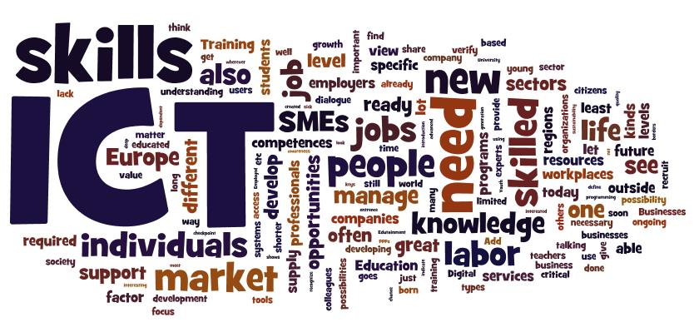

Slide 7
There is an overall mismatch between what the market is demanding and what institutions of learning are providing.

Slide 8
Youth with more advanced ICT skills can take advantage of an even wider range of opportunities brought by the growth of the “app economy,” mobile phones, social media, and the game industry.

Slide 10
The offshore services industry has turned into one of the most dynamic sectors, employing directly more than 4 million people around the world.
The ICT revolution allowed the separation of production and consumption of services,
changing the way companies do business.

Slide 11
The global increase in the use of mobile technologies is playing a key role in expanding employment opportunities for youth.
The fields of ICT repair, maintenance, and sales are explored as they to be a source of employment for young people
Most workers are compensated via electronic
payment systems, such as PayPal.

Slide 12
Jobs in the app economy can be categorized as follows:
IT-related jobs that use app economy skills—the ability to develop, maintain, or support mobile
applications.
• Non-IT jobs (such as human resources or marketing) which support app developers in the same company.
• Jobs in the local economy that are supported by app developers.

Slide 13
Opportunities exist for developers to produce apps that are relevant in terms of both local language and content.
In response to demand by local mobile entrepreneurs, a number of incubators, or “labs,” focused on mobile entrepreneurs have been established.
Games are considered to be the most lucrative apps.

Slide 14
A recent OECD report argues that promoting ICT skills in the green and smart economy pays a double dividend by encouraging job creation and accelerating the transition to green growth.

Slide 15
Green & smart ICT

Slide 16
Internet services used for seeking jobs include:
• CV preparation;
• job counselling;
• employee connection services;
• information on local labour markets;
• sector-specific training, often in collaboration with industry;
• language training, especially English.

Slide 17
Examples of strategies that have proven effective include:
Develop a culture of entrepreneurship by providing training that encompasses innovation, personal development, leadership and business skills.
• Ensure access to business, legal and related information to help new entrepreneurs in the early stages of their business development.
• Simplify business registration processes.

Slide 18
Provide financial incentives for new entrepreneurs:
through loans ; seed funding; grants; reduced tariffs and taxes; reduced cost for licences and registrations, and; financial advice.
provide access to microcredit.
Financial assistance should be complemented with mentorship and other support.

Slide 19
•
Promote and support collaborative innovation spaces, including co-working spaces, tech hubs, business incubators, and hacker/maker spaces.
Organize and offer mentorship opportunities for youth to learn from more experienced
business people.
Entrepreneurship skills and support Toolkits and training programmes (IBM, HP,Microsoft).

Slide 20
Actions implemented in Tunisia
Strategic National Plan 2020: Smart Tunisia project, e-gov, e-health, e-justice, …
implementation of ecosystems to facilitate innovation and creation of startups : Incubators in teknoparks (5)
Capacity building programmes in ICTs for students in transition to work.
Many events are organized in Tunisia about mobile applications and startups : Startup Rally 2017, Alecso awards for mobile applications for arab youth.
"Forsati" programm is a new approach of relationship between Job seeker and employment's structures.

Slide 21
Cybersecurity against hakers and criminals

Slide 22
Protect youth from internet addiction and social isolation

Slide 23
Thank you

