Slide 1
Notes:
OVER ALL OBJECTIVES:
Strengthen youth policies and Program through the development of innovative tools and approaches to tackle emerging social challenges in the context of the school -to-work transition.
Main Objective
Strengthen the capacity of governments and other actors, including youth-led organizations, to develop regional knowledge management systems on youth development
Aim
To assist governments and youth-led organizations in developing inclusive and sustainable development policies in the ESCAP ECA and ESCWA regions through the use of an on-line Youth Policy Toolbox.

Slide 2
SITUATION IN THE PHILIPPINES
National Youth Assessment Study (NYAS) 2015
Youth: 15-30 y/o (RA 8044)
76.6% OSY
76.1% unemployed
63.9% employed
65.3% working youth who are not studying have NOT graduated from college
35% OSY are looking for a job
17.5% OSY are not interested in working
19% find it difficult to look for one
Notes:
Situational Analysis

Slide 3
PROVIDE SUPPORT
INCREASE UNDERSTANDING
ENHANCE ENGGAGEMENT
Notes:
The focus of the Project.
April 2017 signing of contract between NYC and UNESCAP
June 28-29, 2017 Workshop
September 2017 Deliverables have been met
Provide support to national initiatives, promoting exchange of experiences, and documenting innovative practices.
Increase understanding among policymakers of the issues faced by youth, strengthening capacity of policymakers to formulate cross-sectoral policies that enhance effective participation of youth in economic, social and political life and,
Enhance engagement between policymakers and youth groups in jointly designing, amending and implementing youth-based policies for inclusive and sustainable development.
Role of ESCAP
Provide guidance and feedback on good practices, videos and training module contributions.
Prepare the programme for and participate in the national workshop, and invite resource persons from other ASEAN countries;
Cover costs related to participation at the interregional capacity development workshop;
Provide guidance on the launch and dissemination of the Toolbox
Provide overall management and coordination of the partnership to ensure smooth preparation of the national workshop.
Role of NYC
Provide at least 10 good practices on smoothing the school-to-work transition;
Run 2 experiments with policymakers (capital city and setting dealing ) and 3 experiments with diverse groups of youth (including vulnerable youth and rural youth) for feedback on the Toolbox;
Provide at least 10 short videos of policymakers and 30 of youth as inputs to the Toolbox;
Host a national workshop to test and apply the Toolbox; contribute to the development of the program for the national workshop,
Support development of training modules for the Toolbox;
Monitor and evaluate youth school-to-work transition related policies and provide inputs to the Toolbox;

Slide 4
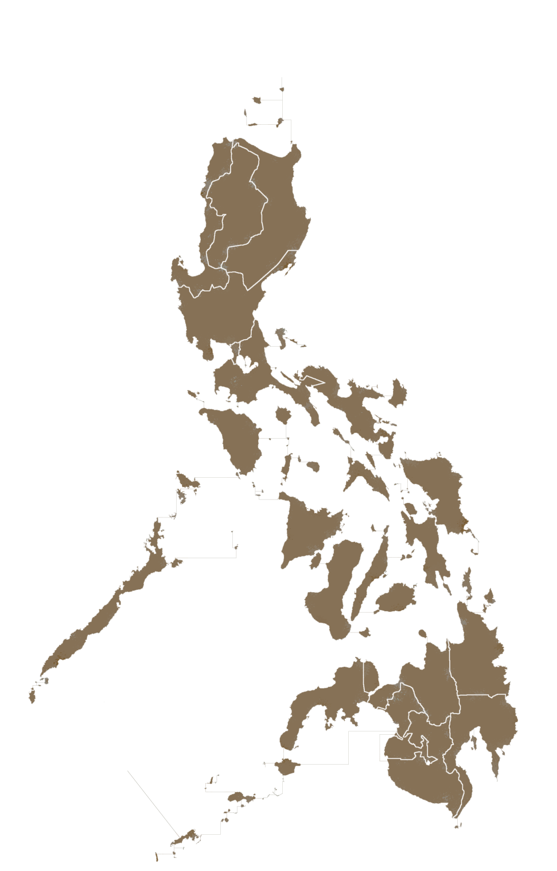
Philippine National Workshop to test and apply the Youth Policy Toolbox
June 28 - 29, 2017
Notes:
Philippine National Workshop
“To test and apply the youth policy toolbox.”
Invited 10 youth leaders and 10 policymakers
Significant Output
Significant outputs from the participants are;
Identification of challenges of the youth in the Philippines
Constructive feedback on the interface and function of the youth policy toolbox
Proposed training modules which will be used as inputs to the toolbox
Challenges
Access to quality and affordable education
Human rights specific to youth
Teenage pregnancy
Unregulated use of media

Slide 5
SIGNIFICANT OUTPUT
Identification of challenges of the youth in the Philippines
Constructive feedback on the interface and function of the Youth Policy Toolbox
Proposed training modules which will be used as inputs to the Toolbox

Slide 6
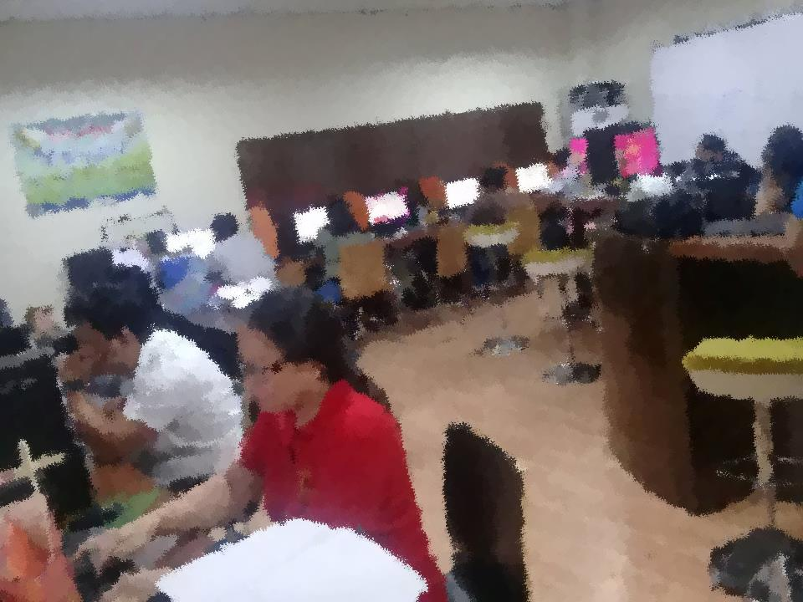
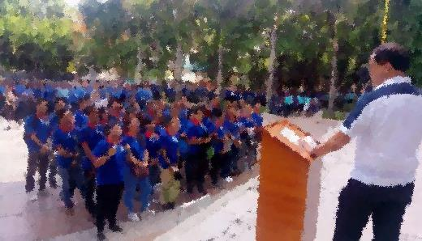
1
K-12
SEED PH
BCLP
JobStart
GOOD
PRACTICES
PESO
FNHSP
GIP
STC
TVET
SPES
Notes:
Barangay Computer Literacy Program (BCLP)
K to 12 Program from 10-year to 12-year basic education, embedded are considerations on globalisation and improvement of the quality of education
School for Experiential and Entrepreneurial Development (SEED) of Gawad Kalinga training for entrepreneurship
La Consolation College Bacolod – Free Night High School Program (LCCB-FNHSP) night high school for those who have not finished yet
Save the Children Youth Employment Programmes
Technical Vocational Education Training (TVET) program under Technical Education and Skills Development Authority (TESDA)
Department of Labor and Employment
JobStart school-to-work transition assistance to youth 18-24 y/o in securing employment from 60% to 80% while increasing efficiency on time looking for a job; information on employment opportunities, trainings and workshops for development of skills
Government Internship Program (GIP) employes youth 18-25 y/o and even those with disabilities, 3-6 month internship under government agencies where they receive monthly stipend, since 2011 it has held more than 25,000 young filipinos, also part of the poverty-alleviation programs of the government
Public Employment Service Office (PESO) PESO is defined as a free charging multi-employment service facility managed by Local Government Units (LGUs) and State Universities and Colleges (SUCs) that upholds equal employment opportunities to every individual covered in the locality by offering job vacancy through referral and placement, career counseling, trainings, and seminars. PESO accommodates various individuals primarily among jobseekers, employers, students, out-of-school youth, migratory workers, and PWDs.
Special Program for Employment of Students (SPES) The programme encourages employment during summer and/or Christmas vacations by incentiviszing employers to hire students, though government support in paying their salaries. Under SPES, students get paid a minimum wage, 60 per cent of which is paid in cash by the employers. The remaining 40 per cent are subsidizsed by the government in the form of vouchers applicable to the payment of tuition fees and books in any secondary, tertiary, vocational or technical educational institution.

Slide 7
YOUTH POLICY
Notes:
Purpose. To know the viability of the toolbox (discuss briefly)
Profile of respondents:
10 policymakers and 10 youth leaders from different parts of the country
Tools used:
Calls: Local telephone or cellular phone
Shared files: Google Drive Folder
Instrument: Google Forms
Results highlights:
60% policymakers said they do not have existing local s-w transition policies
All respondents said that the Toolbox will help them learn more about s-w transition policies
All respondents use the internet to “learn” but mostly through social media, a few through MOOC or other online courses
40% respondents have not taken any online courses
All youth respondents said that toolbox is relevant in their community
All respondents have internet access but others are a bit limited
11% said that their connections are not strong enough to watch videos
Only 60% policymakers are willing to host youth in their offices if in case youth want to learn through the toolbox
Only 50% of those can provide stable internet connection
Key Risks
Local chief executives are not supportive of the Youth Toolbox
Local policymakers are not technically savvy
Local policymakers are supportive but not actually implementing the Youth Toolbox
Content of the Toolbox is not considered practical or localised by policymakers because it seems too different from their local context / difficult to localise success cases from outside the Philippines to local context
Content of the Toolbox is not considered practical or localised by youth leaders
Challenges to running Experiments in the Philippines
Using Skype or video conference programs or applications especially among policymakers is very common
Many of the invited participants do not check their emails
Some participants are busy and are therefore not available for long phone calls, much more video conference calls
Time-constraint

Slide 8
HIGHLIGHTS
60% policymakers said they do not have existing local school to work transition policies
All respondents said that the Toolbox will help them learn more about school to work transition policies
All respondents use the internet to “learn” but mostly through social media, a few through MOOC or other online courses
40% respondents have not taken any online courses
All youth respondents said that the Toolbox is relevant in their community
All respondents have internet access but others are a bit limited
11% said that their connections are not strong enough to watch videos
Only 60% policymakers are willing to host youth in their offices if in case youth want to learn through the toolbox
Only 50% of those can provide stable internet connection
Content of the Toolbox is not considered practical or localised by youth leaders

Slide 9
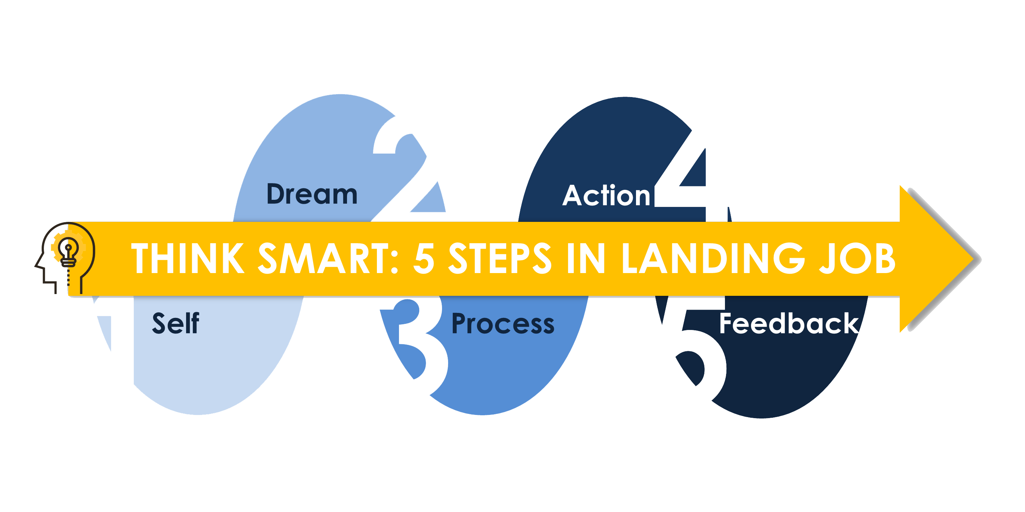
Personal Strategic Planning Towards Youth Employment
Notes:
The Module
“ Personal Strategic Planning Towards Youth Employment”
“ Think Smart : 5 steps in Landing a Job”
UN Volunteers
Self – personality tests, SWOT analysis, knowing personal competencies
Dream – SMART goals (specific, measurable, achievable, relevant, time-bounded), goal-setting
Process – resource mapping (support system, finances, networks, learning materials), opportunities they can explore (trainings and scholarships, vocational, employment, freelance and part-time job opportunities, entrepreneurship)
Action – landing a job, resume making, gaining confidence, interviews, timelines
Feedback – self-evaluation, peer evaluation, career checklist

Slide 10
CHALLENGES
Enhance inter-agency coordination
Overlapping programmes
Gaps in monitoring and evaluation
Time-frame
Research on content of training module
Mainstreaming of Youth Policy Toolbox

Slide 11
MOVING FORWARD
Launch the Youth Policy Toolbox and implement the advocacy plan to all youth policy stakeholders
Inclusion of the marginalised youth (out of school youth, ethnic youth groups, youth with disabilities, etc.)
Accessibility of youth stakeholders in the grass root level (local)
Integration of Youth Policy Toolbox monitoring and evaluation mechanisms in the NYC

Slide 12
December 2017, 1st Week
Develop and implement Youth Policy Toolbox Advocacy strategies 2018
YOUTH POLICY
TOOLBOX 2017
Mabuhay and maraming salamat po!
Notes:
Deliverable
Launch the Toolbox , 1st week of December , 2017
Develop and implement a sustainable youth policy toolbox dissemination strategy to all youth stakeholders in the Philippines
Integrate the Policy toolbox in the National Youth Commission Website
Acknowledge and thanks to the following important people who provides technical assistance and guidance in enabling us to achieve the partnership goal of NYC and ESCAP regarding the youth policy toolbox:
Marco Roncati of UNESCAP
Bryce Hartley of UNESCAP
Chaveemon Sukpaibool (Ms.Ning)
TANDEMIC:
KAL
EMMA
National Youth Commission, Officials and staff, headed by Chairperson ; Aiza Seguerra; special thanks to Commissioner James Ceasar Ventura , and Commissioner Ronald Cardemas, for providing a youth lense perspective in

