Slide 1
Promoting the sustainability of the youth policy Toolbox
in Asia-Pacific
21 – 23 November 2017- Bangkok
COUNTRY PROGRAMME
SRI LANKA
National
Youth
Services Council
Foundation for
Strengthening
Human Skill

Slide 2
Objectives
Share and teaching among ourselves of the activities introduced and incorporating the initiatives that identified by the partner countries.
Getting feedback from the participants to develop and expanding the services lineup.

Slide 3
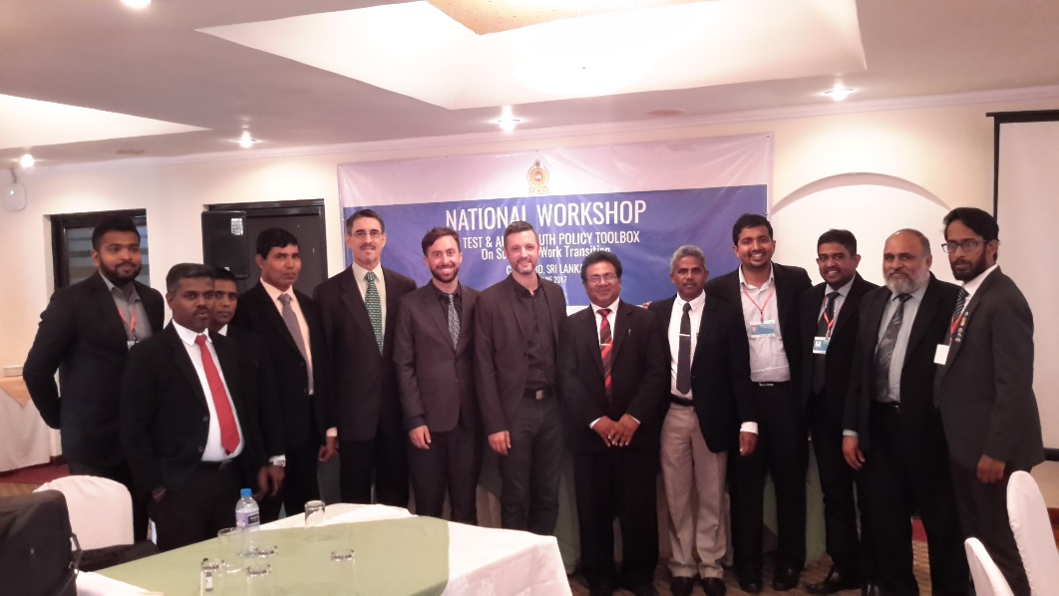
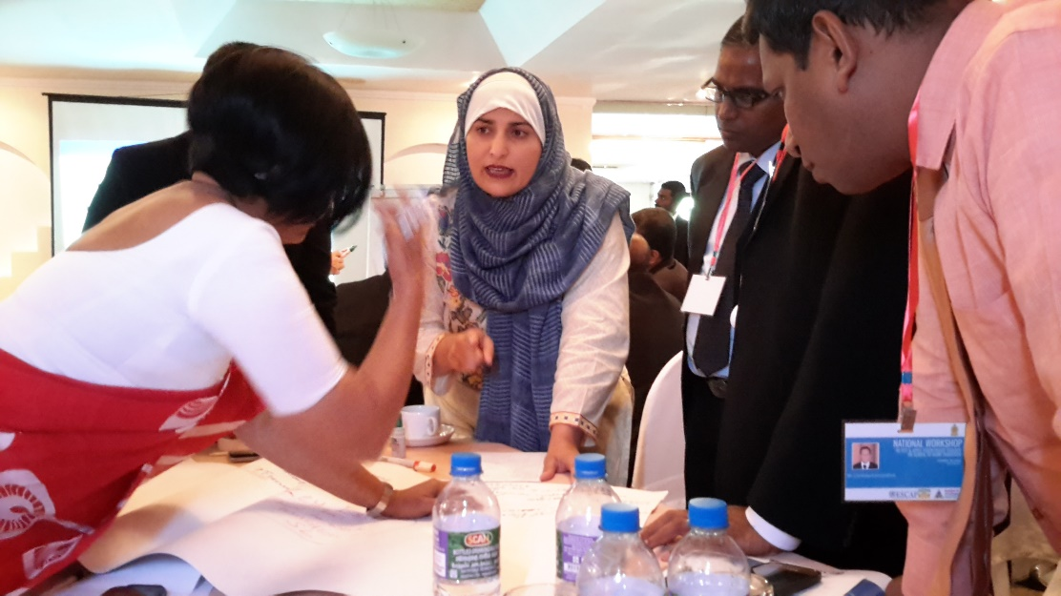
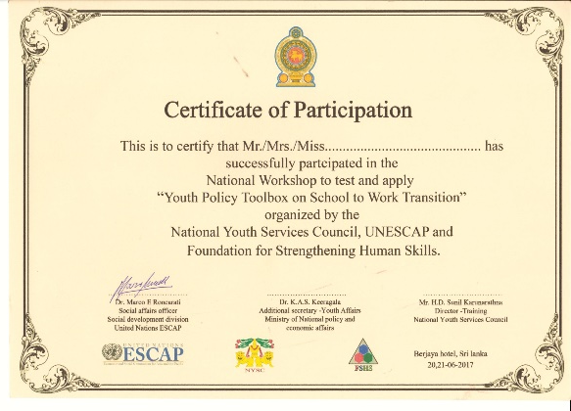
Activities identified
Cont’d
Delivering an awareness and building capacity of the stakeholders through organizing National workshop.
Making Short videos with policy makers and stakeholders on their role and responsibilities of utilizing the online resources.

Slide 4
Cont’d
Compiling policy analysis available within the
institutions both private and public.
Organizing stakeholder workshop for developing Training Modules (trilingual – English, Sinhala and Tamil)

Slide 5
Developing 10 Good practices,
Free of Charge Vocational Trainings form Government.
Career Guidance & Counselling system. (NYSC / TVEC / VTA / NITA)
Career path planning & SYB (Start your business)
National Vocational Qualification (NVQ’s) Equivalent to G.C.E. O/L & A/L in the same field.
Government oriented developmental services such as CGC. EDT, Private Public Job opportunities, Health & wellbeing programs, women empowerment programs act,
TVET Provision for Vulnerable People seeks to address access issues related to TVET.
Youth Corps – Preparing to face the new challenges in nation building.
Employment creation - Public employment Service (PES) centres + e PES
Government and Private sector Internship/ Industrial training opportunities.
SRI LANKA SKILLS - Ten+One Program

Slide 6
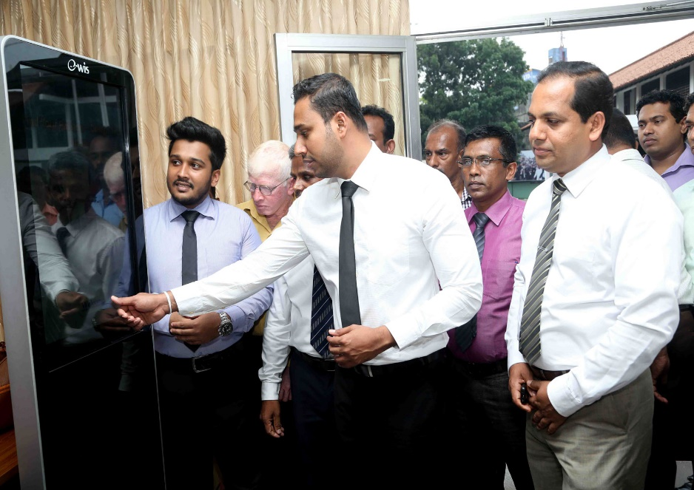
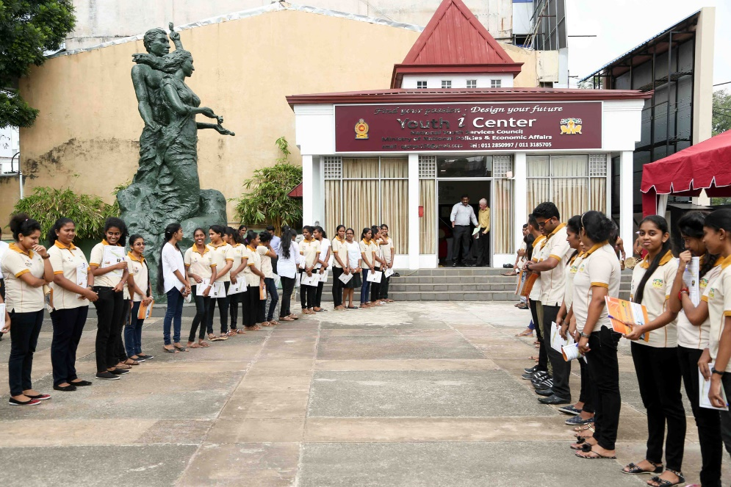
Establishment of Youth I Centre. As a result of the Initiatives taken-up, We started Career guidance & Counseling center in NYSC to extend career base services to the community.

Slide 7
National launching
Planned to be held on 4th December 2017 with over 1500 youth across the country. Simultaneously , it will be organize a plenary dialog with five leading companies in Sri Lanka Job & Educational exhibition cum Fair.

