Slide 1
Монголын Залуучуудын Холбоо
Иргэний Боловсролын
Төв
Монголын Залуучуудын Эвсэл
“Information on activities in support of the project, including challenges and solutions’’
Mongolia

Slide 2
Financing organization: Implementing organization:
Partner organizations:
Mongolian Youth Federation
Center for Civic Education
Mongolian Youth Council

Slide 3
List of activities:
Provision of good practices
Running experiments with policy makers and youth for feedback on the Toolbox
Provide short videos of policy makers and youth
Host a National workshop to test and apply the Toolbox
Creating training module for the Toolbox
Monitor and evaluate youth school-to-work transition related policies
Participate in the project’s interregional capacity development workshop
Launch the Toolbox and develop, implement a related dissemination strategy. (Planned to organize on 2nd December)

Slide 4
Good practices
Business support by Development solutions NGO- Mongolia
Cooperative vocational training in the mineral resource sector
Youth Labor Exchange Center – Mongolia
Ulaanbaatar Soup- Mongolia
Program to support Youth Employment
“Future owners” campaign for youth to assist career choice
“Part time” project
“The Young Mongolian with job and income” program
Program to support employment for youth and graduates
Supporting youth with disabilities

Slide 5
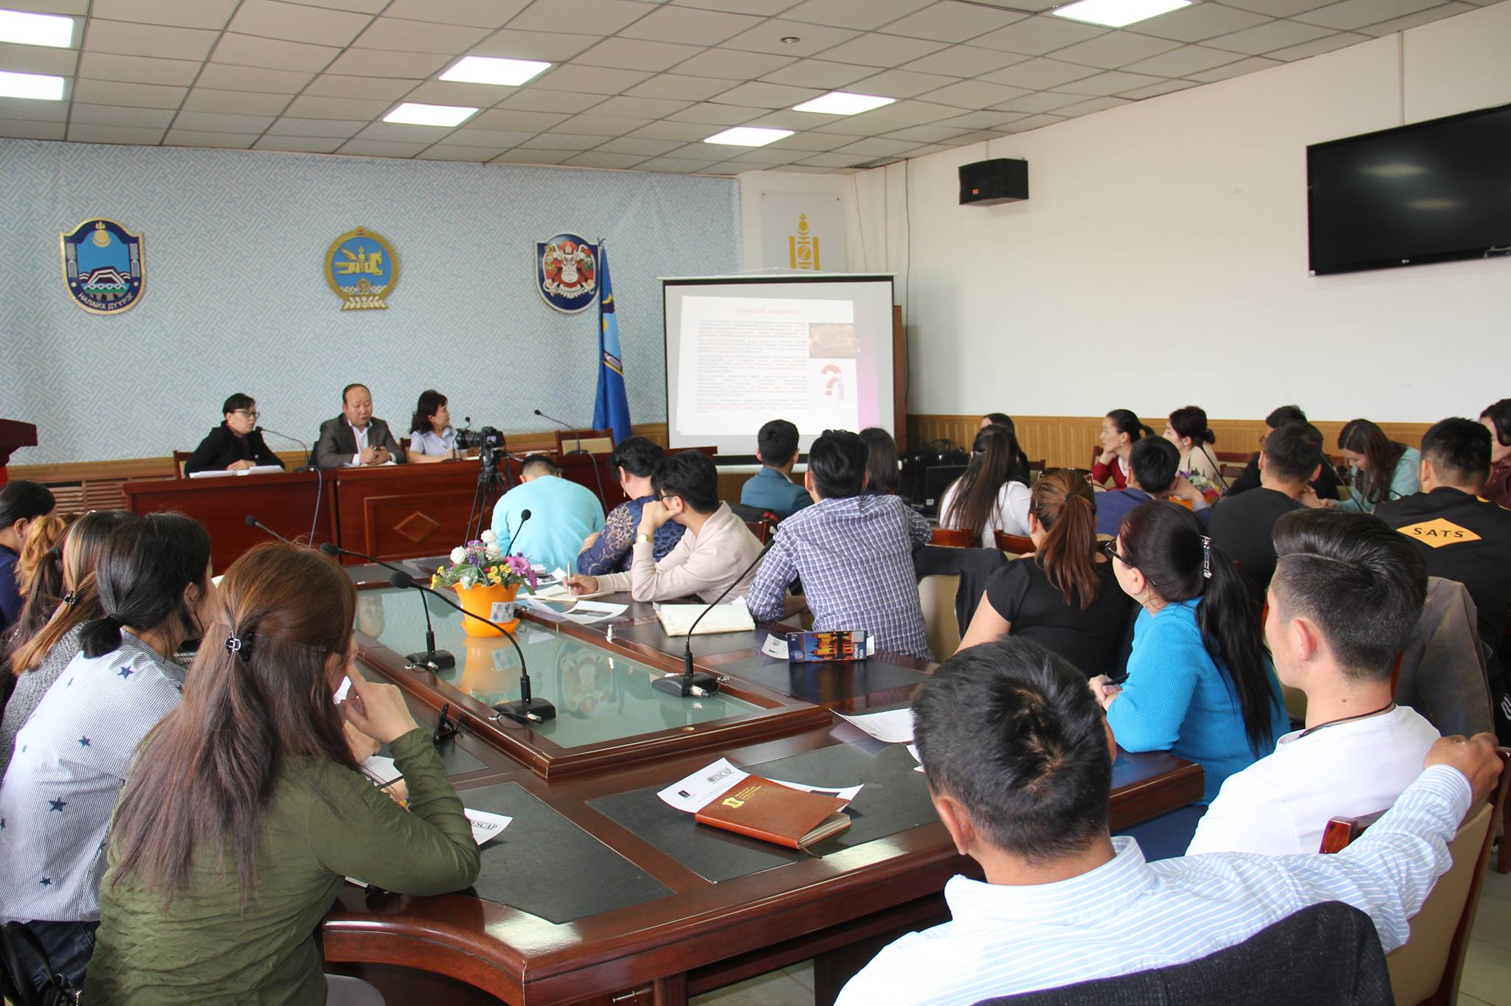
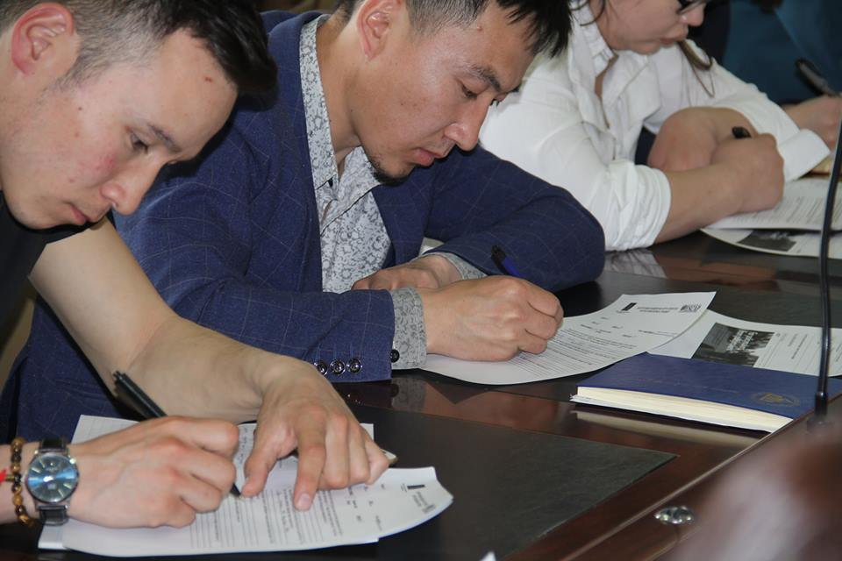
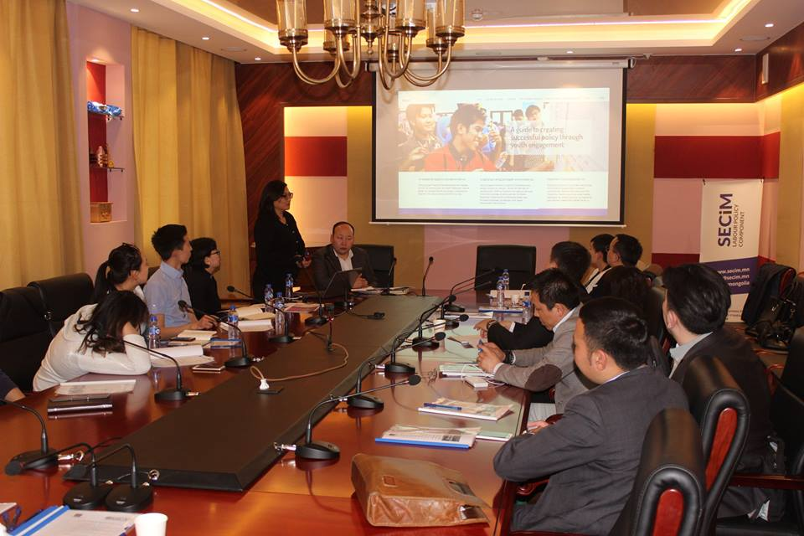
Running experiments:
5 experiments with policy makers, youth NGOs and youths
2 in Ulaanbaatar and 3 in rural areas.
Total 150 people involved in experiments.
Date: 01 -25 may 2017.

Slide 6
Running experiments
Challenges to run experiments in Mongolia:
The method of running experiments.
Language barrier - some concepts difficult to translate
People prefer oral communication
There are differences in internet access when it comes to rural/ urban participants

Slide 7
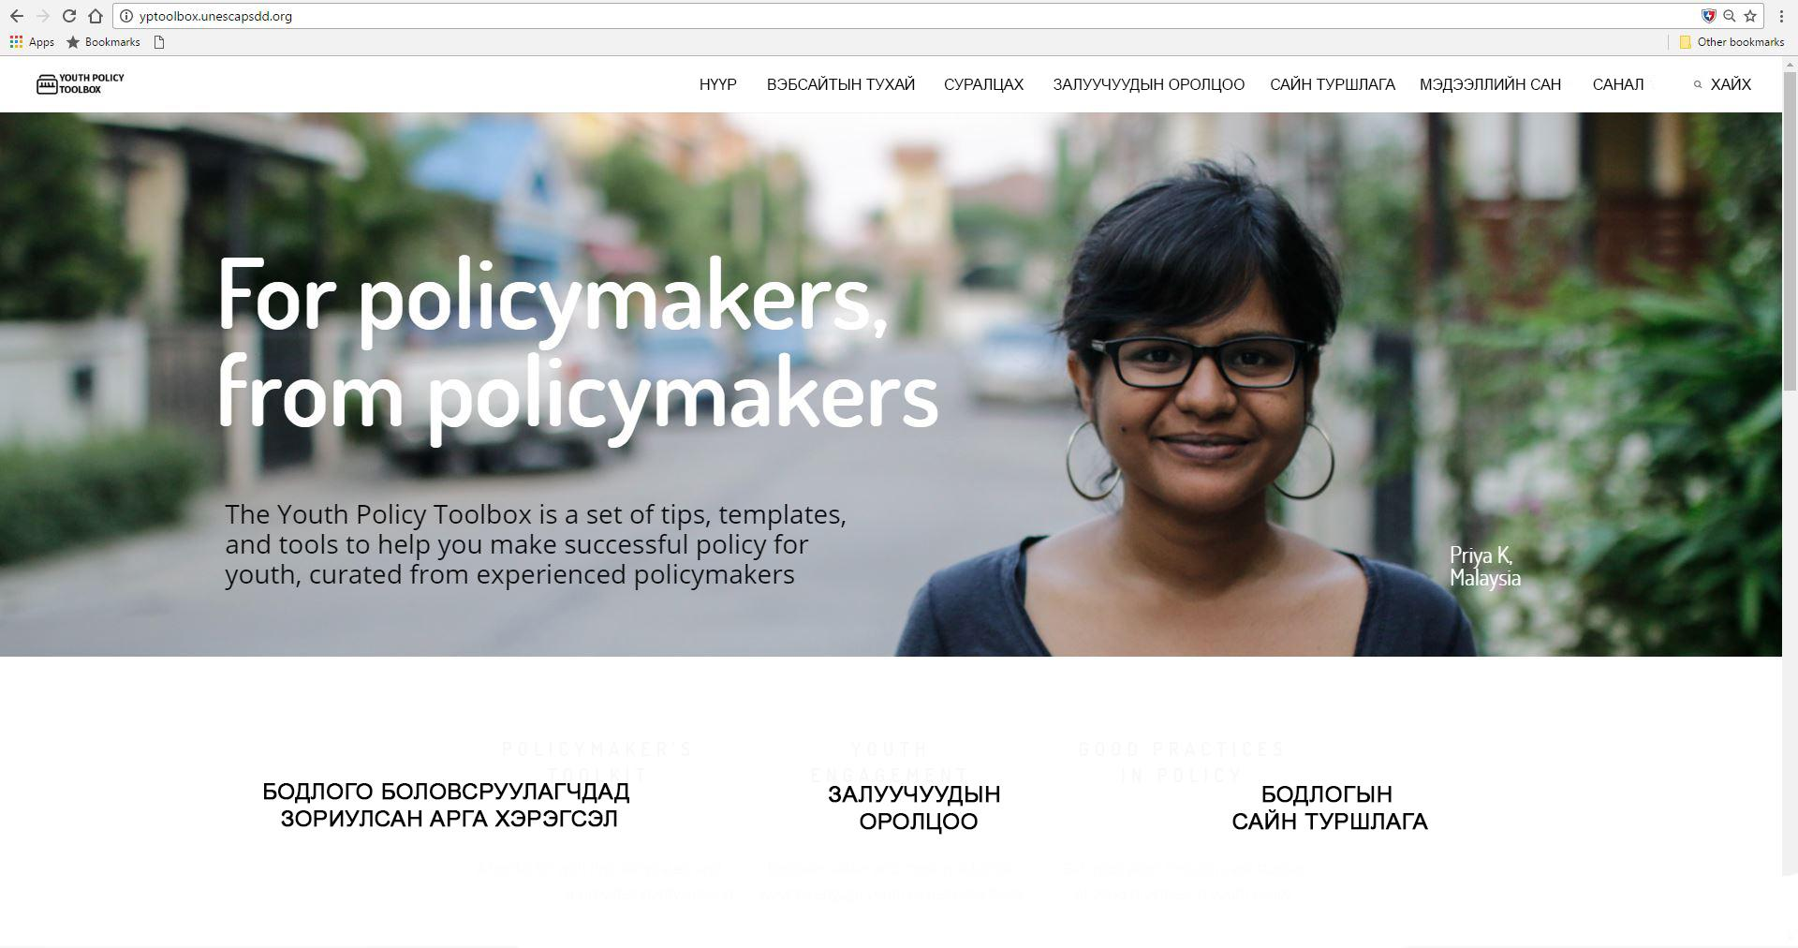

Slide 8
Provide short videos:
3 short videos had been prepared and sent to ESCAP team ;
https://www.youtube.com/watch?v=cwLrmkHJnW4&feature=youtu.be
https://www.youtube.com/watch?v=rt95MkSNDTs&feature=youtu.be
https://www.youtube.com/watch?v=YoFMUdz_Ma0&feature=youtu.be

Slide 9
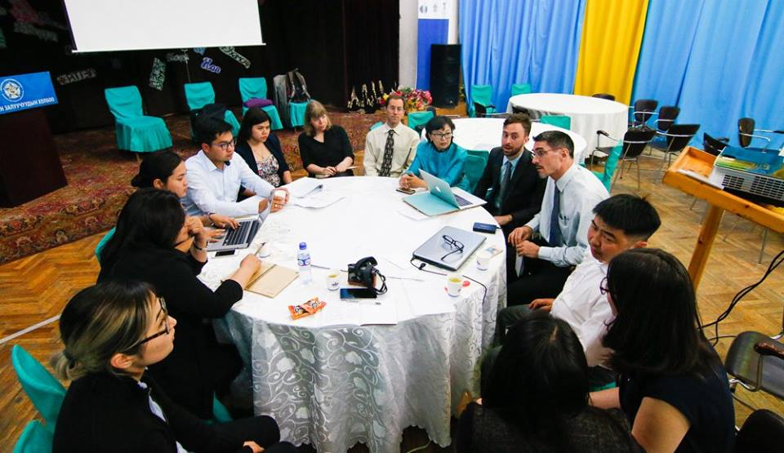
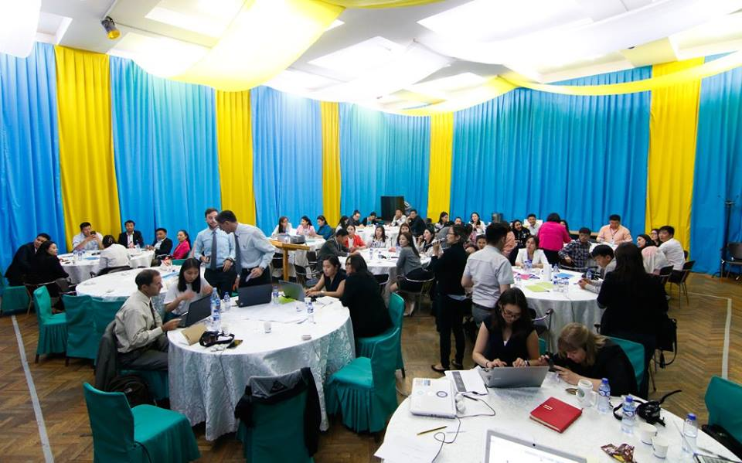
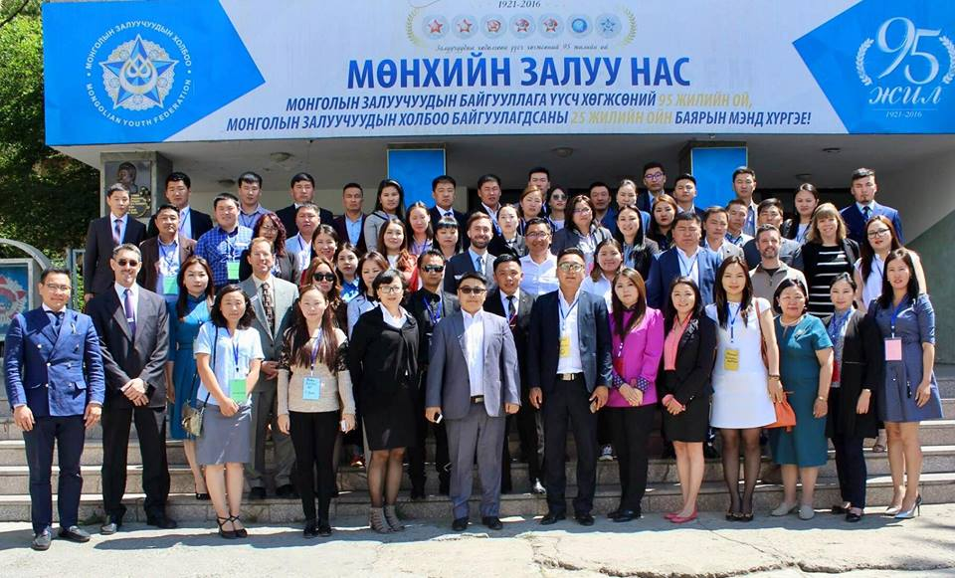
National workshop:
When: June 06-07, 2017
Where: Ulaanbaatar, Mongolia
In collaboration with representatives of the Asia Pacific Regional Economic Commission
Government and civil society representatives
100 participants from 21 aimags and 9 districts

Slide 10
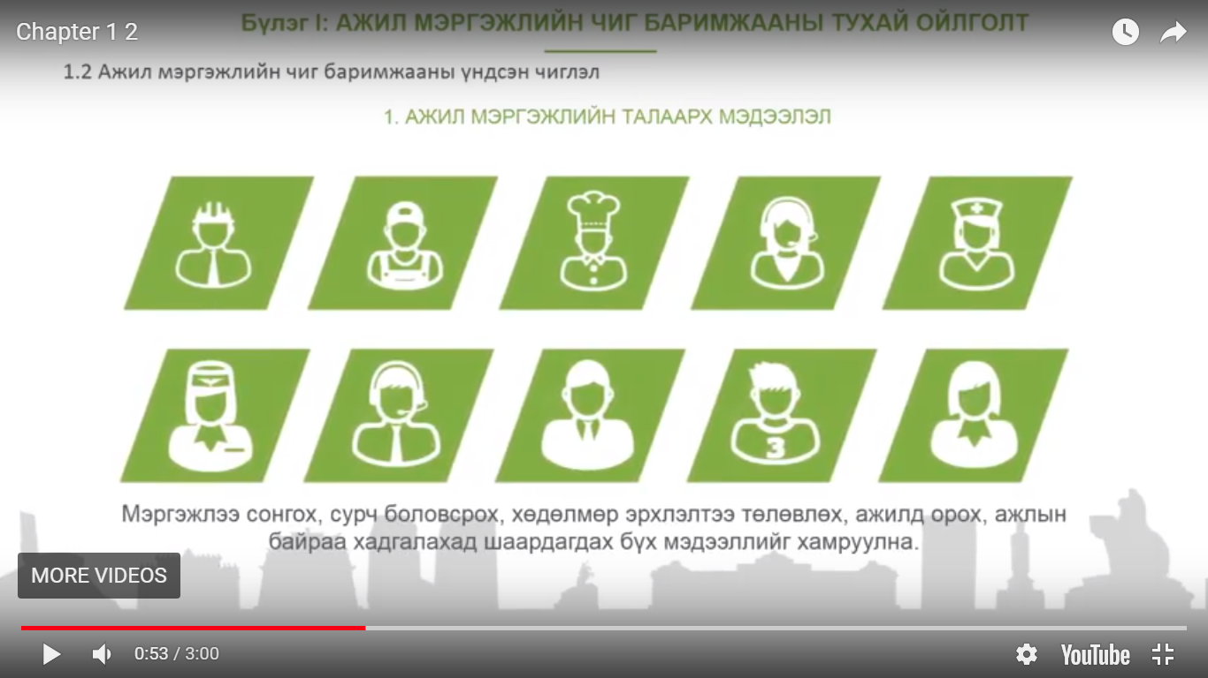
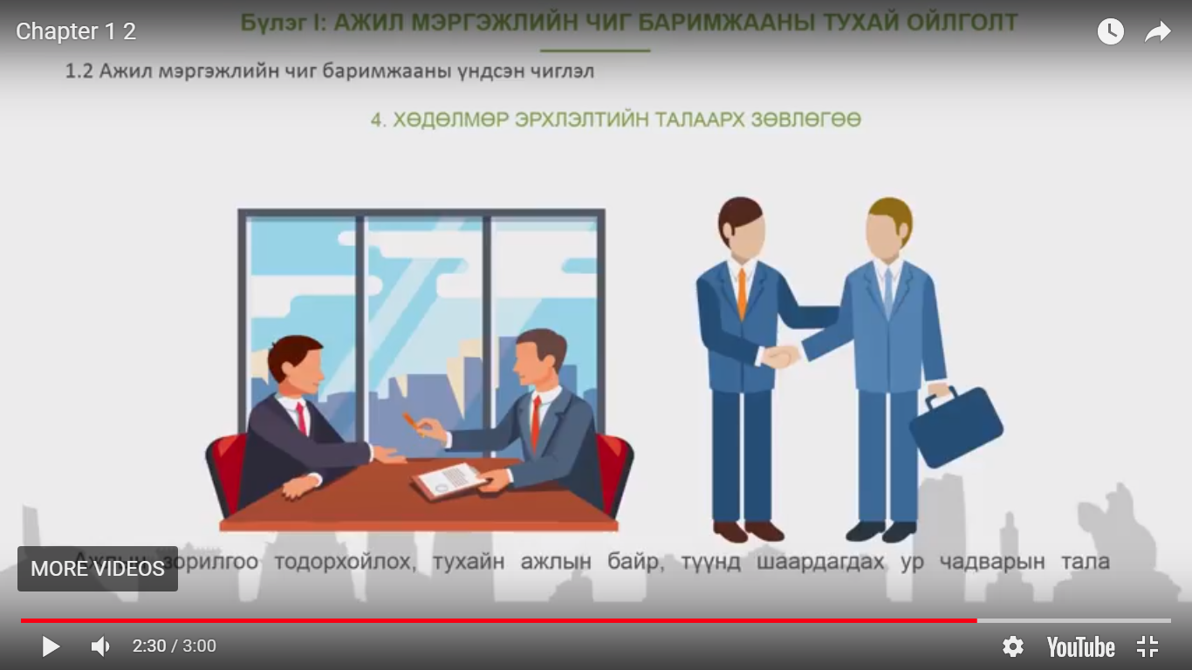
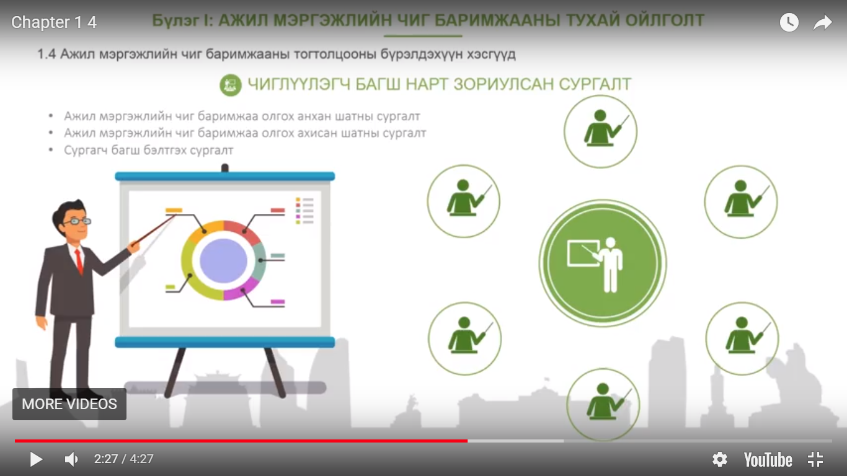
Creating training modules:
Training modules on Career guidance with 4 chapters.
Chapter 1: Basic concept of career guidance /45-60 minutes/
Chapter 2: Information on career guidance /45-60 minutes/
Chapter 3: Counseling on career guidance /135-180 minutes/
Chapter 4: Information resources and further reading /15 minutes/

Slide 11
Monitoring and evaluation
Employment Promotion Law, Law on vocational training, Law on higher education, Law on youth development,
Mongolia Sustainable development goals 2030, Action plan of the Government 2016-2020,
State policy on education, Job coaching and employment skills development program, Youth Employment and Start-up Business Development Programme

Slide 12
Monitoring & evaluation: Challenges & solutions
The Law on Employment does not address youth issues or school-to-work transition, specifically.
Youth group should be indicated and the role of ‘’educational institutions’’ should be clarified in regulating school-to-work transition.
The fact that vocational education belongs now to the Ministry of Labor has reduced the importance of the issue to be linked to the education sector.
It also needs to clearly define intersectoral coordination of vocational education. For example, the coordination and accountability between the Ministry of Education and Ministry of Labor is necessary.
Inadequate quality of education is the cause of unsmooth transition to school-to-work.
When defining vocational education policy and training program, it is crucial to ensure that the linkage of policy to be closely aligned with labour market.

Slide 13
Монголын Залуучуудын Холбоо
Иргэний Боловсролын
Төв
Монголын Залуучуудын Эвсэл
Анхаарал тавьсанд баярлалаа!

