Slide 1
Report on Youth Policies in Education
A Youth Perspective
Hamza M. ARsbi

Slide 2
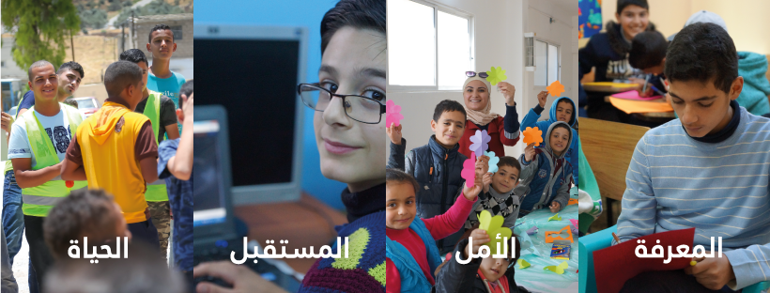
I Learn – About Us
A non-profit initiative that employs a community-based approach to empower youth and children in disenfranchised communities. Through informal education, youth volunteerism, and global partnerships we seek to establish safe spaces that encourage innovation, intellectual growth, and critical thinking.

Slide 3
I Learn: Core Module and Best Practices
Leveraging existing public spaces as engagement hubs for youth.
Creating a support network to provide resources for youth.
Growing youth engagement through social media.
Youth to youth programs that provide resources for local communities.
Notes:
- By leveraging already existing public spaces in Jordan we were able to use them as the hub from which to solve local challenges and engage youth from all walks of life - By creating different bubbles of support like a network of startups and public sector and private sector we were able to engage and decentralize the wealth of knowledge and resources and deliver to the young people who needs it - Continuous engaging content on social media that show case the success stories of our youth we were able to engage more young people into civic engagement in their local and national aspect - As a youth led initiative we were able to deliver meaningful education and resources to the local community that helped on creating hubs that helped them to overcome some of the challenges they face.

Slide 4
The Report
With a focus on Education and Entrepreneurship, the report aims to:
Examine the main issues facing youth.
Take the youth perspective on which policies matter to them.
Provide a view of youth aspirations.
Give examples of possible solutions provided by youth for policy challenges.

Slide 5
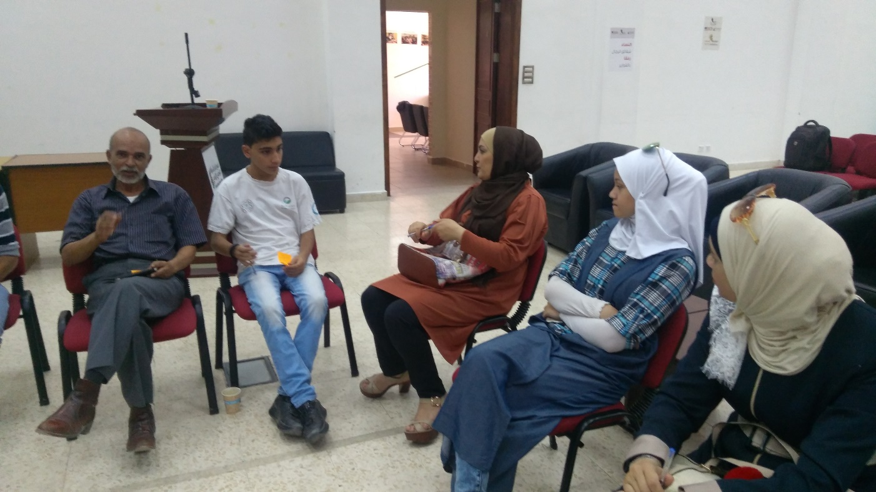
Design: Focus Groups - Reach
The workshops were conducted in three regions across Jordan, covering the Northern, Mid, and Southern Governorates.
Some were conducted inside refugee camps.
The attendees represented three groups:
Youth under 18.
Youth between 18 and 30
Organizations representing youth.

Slide 6
Design: Focus Groups - the question
The main questions asked of the attendees:
What are the main issues that matter to youth?
What are the most important policies to youth in Education and Entrepreneurship?
What do youth aspire to improve?
What practical policy solutions do you have to the challenges facing youth?

Slide 7
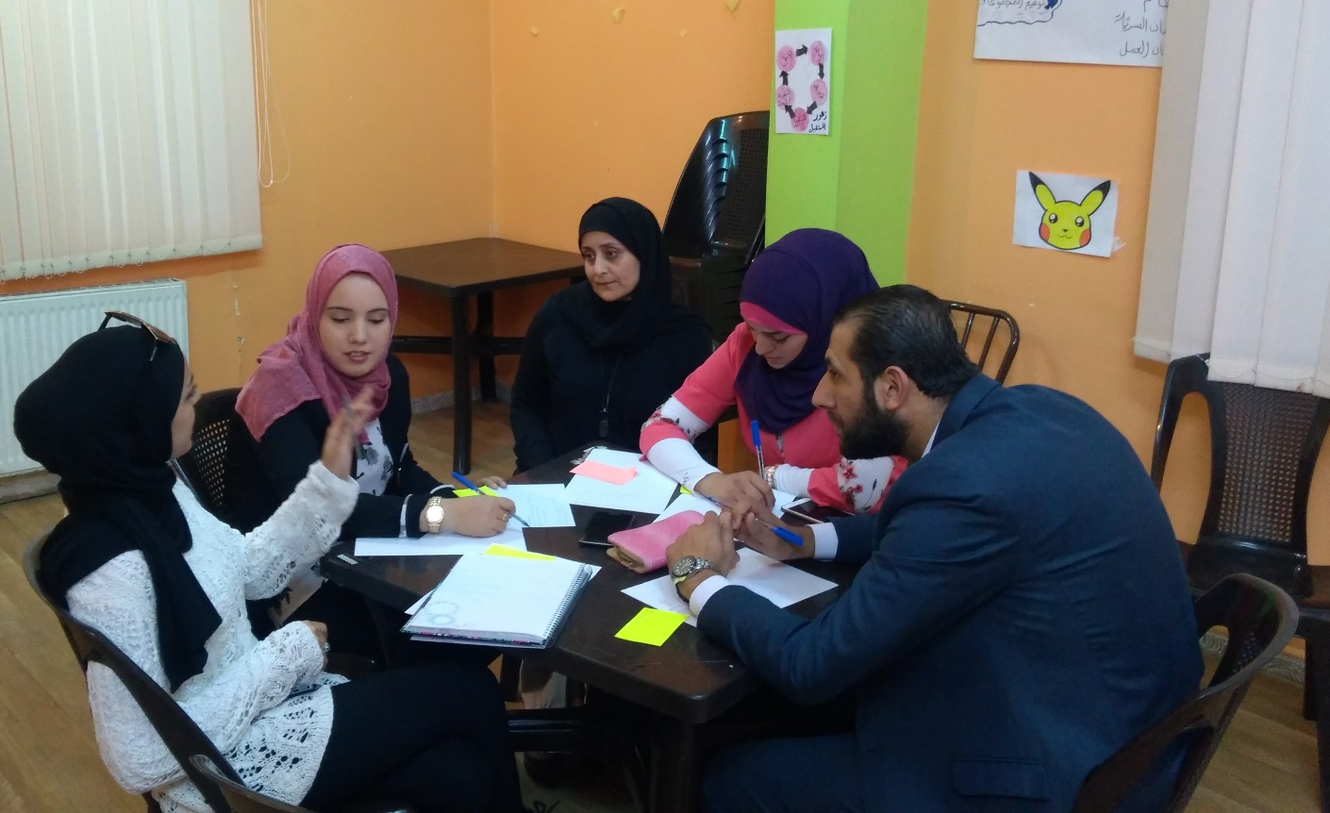
Design: Focus Groups – a creative approach
Youth to Youth approach
Two Step Focus Group:
Creating Context through creative methodologies. From picturing to the six thinking hats.
Providing Youth Recommendations through small groups and discussions
Notes:
Picturing context: creating an agreed on image of the current situation.
Six Thinking Hats: is an approach to examine the assumptions made by the participants, by looking at the decision from a range of different perspectives.
Wishing exercise: to give maximum freedom in imagining how the situation can be better.
Group Discussion: to narrow down the solutions into what is possible.
Brain-writing: each person expresses their ideas through writing and builds on the ideas of others.
Initial Recommendations: the small group chooses a topic and builds a practical solution.
Idea Market and Discussion: groups share their ideas for a wider discussion.
Final Recommendations.

Slide 8
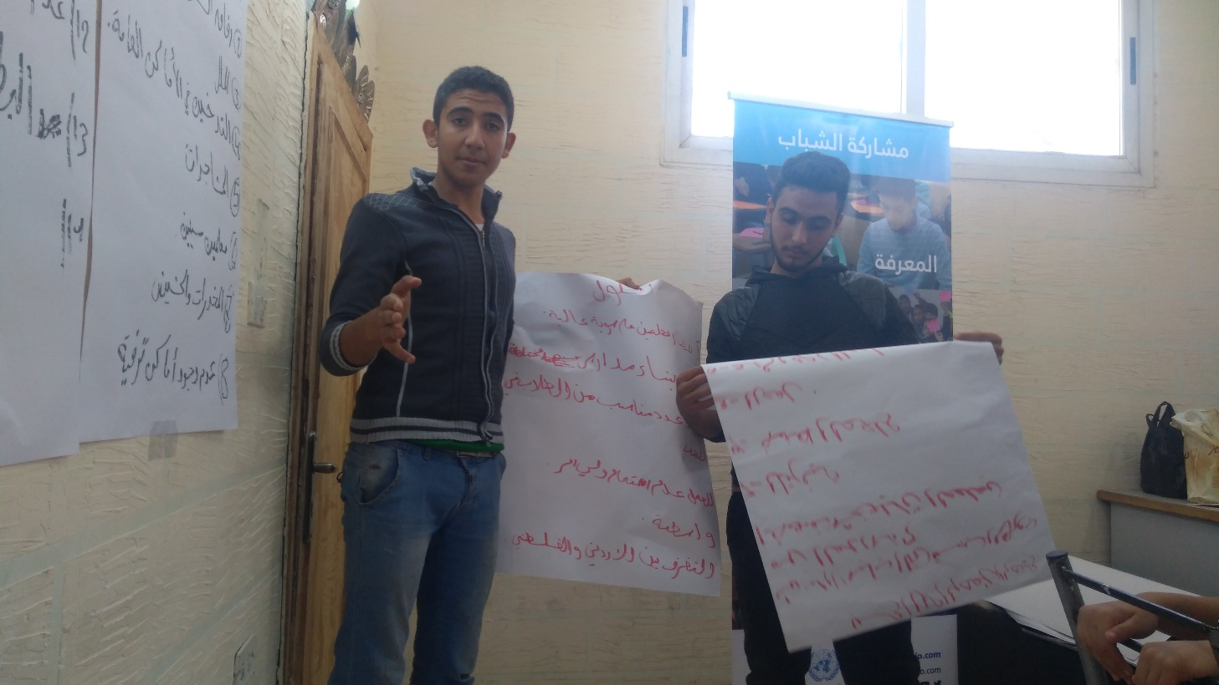
Results: Main Issues Facing Youth
Unemployment.
Weak educational outputs.
Feeling of insecurity, inequality, and the lack ability to express opinions freely.

Slide 9
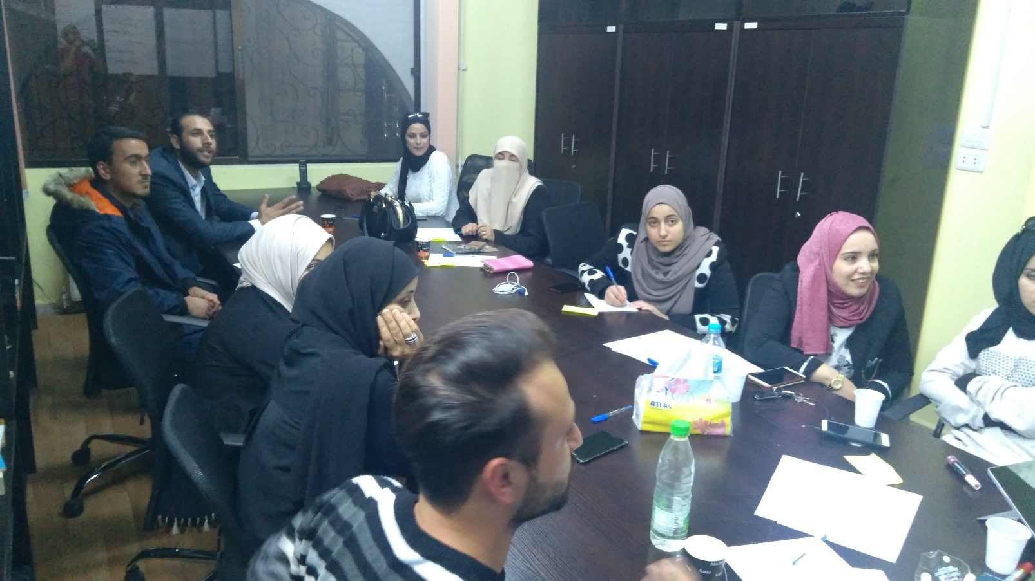
Results: Proposed solutions
Overhauling the curriculum.
Providing Teacher training and increasing teacher pay.
Activating school labs and clubs to keep students engaged.
Policies advocating more awareness and equality between students.
Creating awareness programs for parents.

Slide 10
Discussion
Even with unemployment and issues concerning safety, the feeling is that improved education and providing spaces for youth could provide a solution.
This report is not conclusive, but can be a seed for a larger efforts.
To insure both impact and sustainability, this report will be shared with ministries and government officials.

Slide 11
Thank You
“There’s a radical – and wonderful – new idea here… that all children could and should be inventors of their own theories, critics of other people’s ideas, analyzers of evidence, and makers of their own personal marks on the world. Its an idea with revolutionary implications. If we take it seriously.” — Deborah Meier

