Slide 1
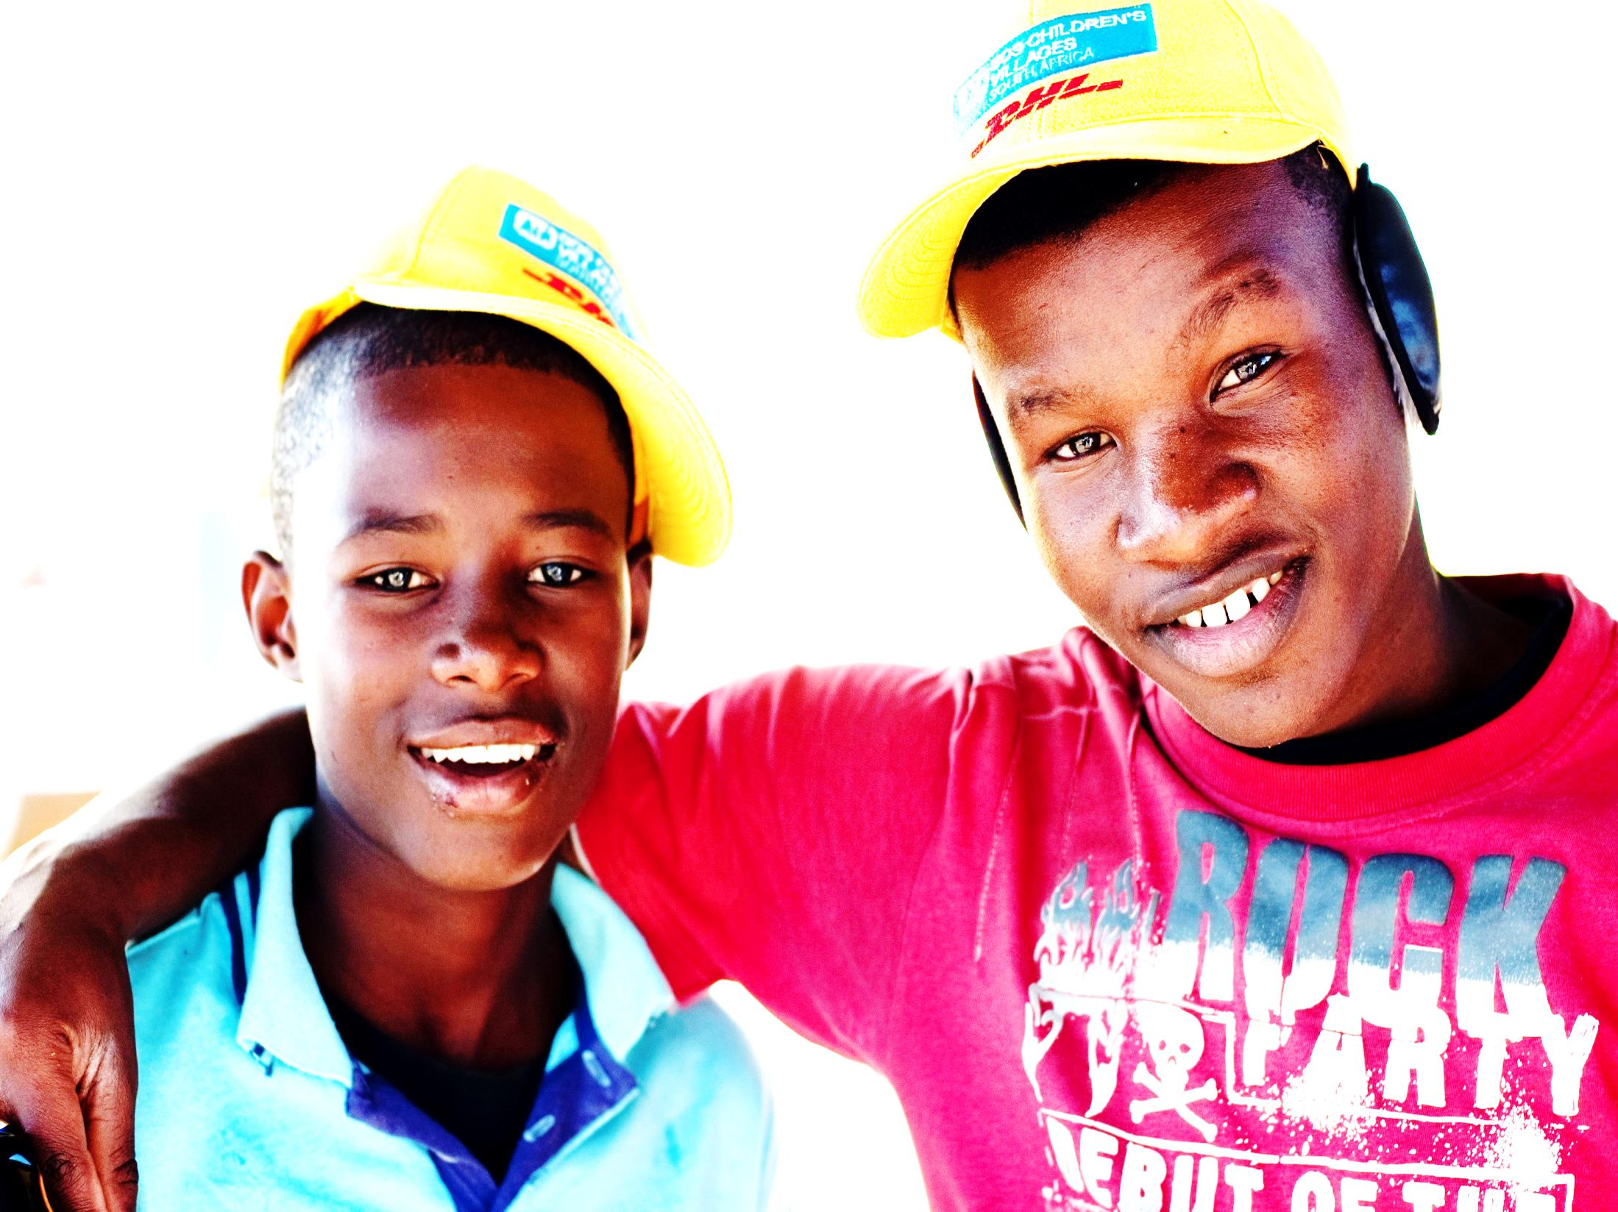
GoTeach Partnership between Dpdhl & SOS Children’s Villages

Slide 2
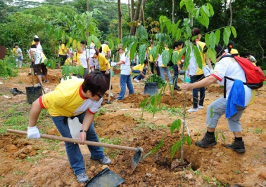
Our Corporate Citizenship priorities
Our CC activities are based upon strategic Corporate Programs and supported by the volunteering efforts of our employees locally
Corporate Citizenship Instruments
GoHelp – Delivering help
Preparing airports with Get Airports Ready for Disaster and helping after natural disasters with our Disaster Response Teams at airports
Providing skill-based help to people in need locally
Strategic Partnerships
… build long-term Corporate Citizenship relations and partnerships
GoTeach – Improving educational opportunity & employability
Supporting children and young people from disadvantaged backgrounds to attain an excellent education and enhance their employability
Global Volunteer Day
…encourage employee volunteering
Living Responsibility Fund
GoGreen – Protecting the environment
…recognize sustainable employee volunteering activities
Protecting the environment and biodiversity in local communities and habitats through hands-on contributions

Slide 3
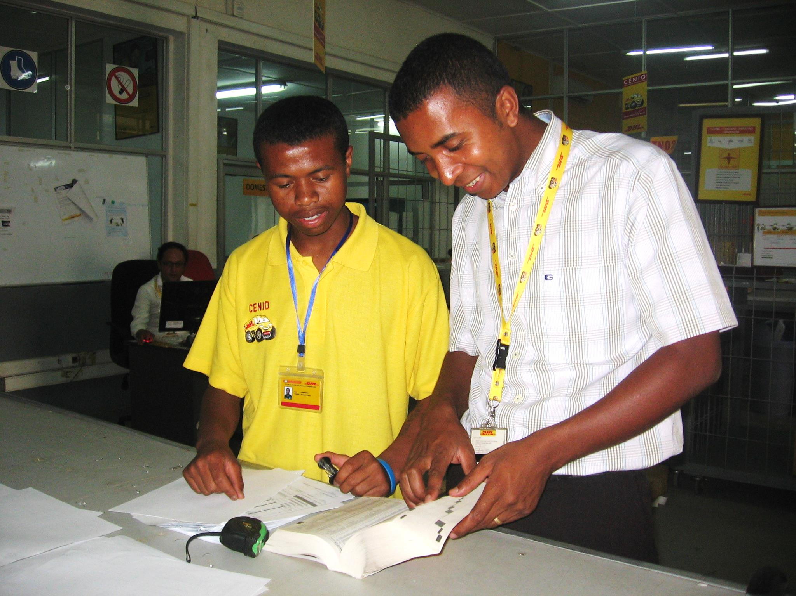
GoTeach – Partnership with SOS Children‘s Villages
Our partnership is designed to help young people as they make the transition from education to world of employment: education, empowerment, employment, entrepreneurship
Strategic partner
Mission
Support young people between 15 - 25 as they make the transition to the world, to support them in their education and prepare them for employment for them to achieve an independent and sustainable life.
Unique Feature
Local employees interact with youths and share their experience and expertise to foster their employability. We encourage them to become role models for the young people.

Slide 4
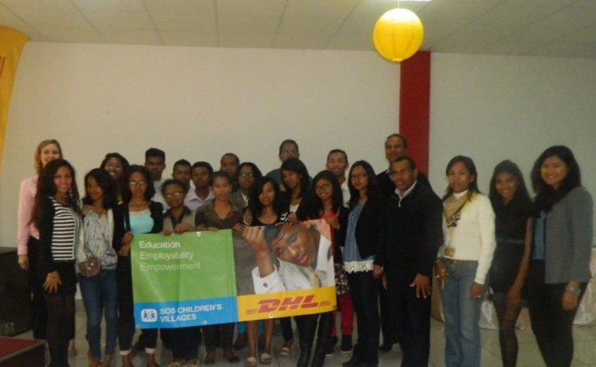
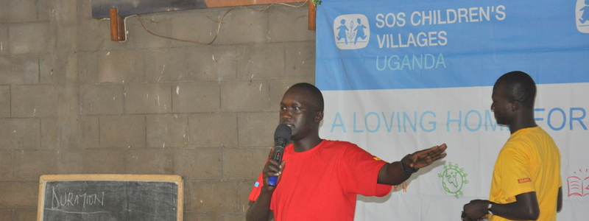
GoTeach – Partnership Activities
Our employees contributing their time and expertise through activities in cooperation with local partners
Soft & basic skills trainings
Exposure to work environment
Job orientation
Individual mentoring
Internship and job shadowing
Entrepreneurship

Slide 5
Partnership development 2011-2015
The growing number of active partner countries manifests the growing demand for partnerships
demand-driven
supply-oriented
Madagascar (2009), South Africa, Brazil, Vietnam
Mexico, Ghana, Kenya
Jordan, Uganda, Morocco, Peru, Ethiopia, Costa Rica, Panama
Indonesia, El Salvador, Thailand, Mauritius, Colombia, Paraguay, Dominican Republic, Haiti, Swaziland, Lithuania, Tanzania, Nigeria

Slide 6
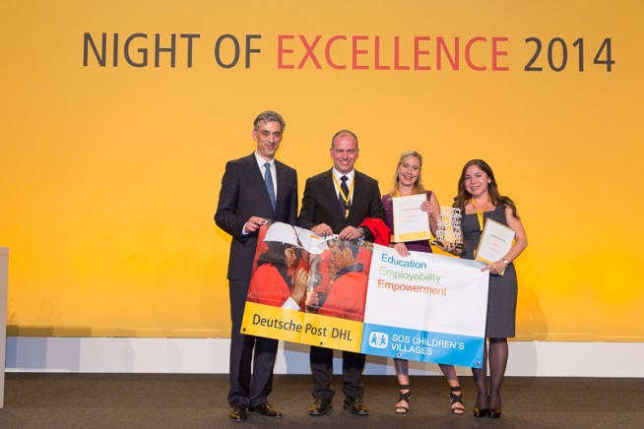
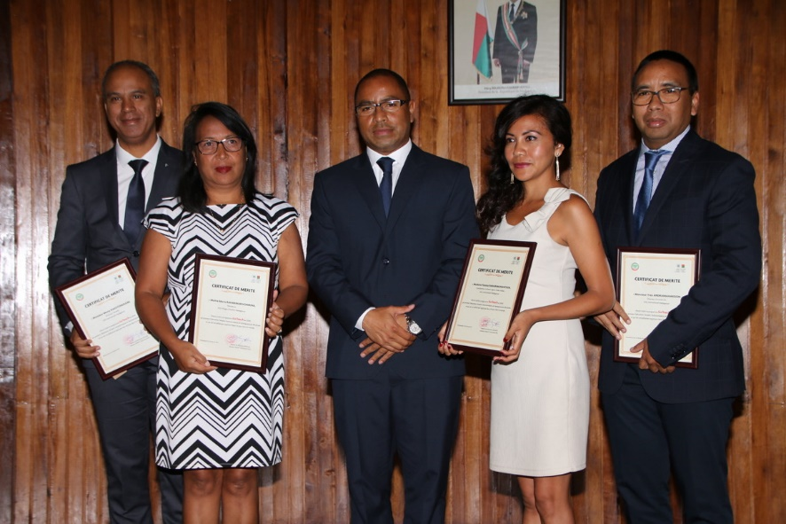
2014: The CEO Award Gold 2014, category Living Responsibility,
goes to the GoTeach partnership with SOS Children’s Villages.
2017: Certificates of recognition from The Malagasy Ministry of National Education
and UNESC0

Slide 7
2016 GoTeach Global Figures
GoTeach Madagascar Figures
172 youth activities
1.736 youth reached
1142 DP DHL employees reached
123 internships and job shadowing
20.000 volunteer hours
40 youth employed
55 external partners
45 activities for youth
2015 youth reached
230 DP DHLvolunteers reached
42 profesional internships
9.000 hours of volunteering
30 youth employed
ACTIVITIES GOTEACH MADAGASCAR UNTIL NOW
Profesional mentoring
Profesional internship
Discovery Trades
Visit of airport and historical sites
Forum of works
Olympics
Youth employment
Global Volunteer Day

Slide 8
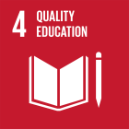
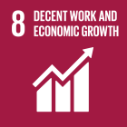
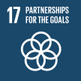
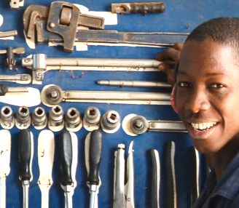
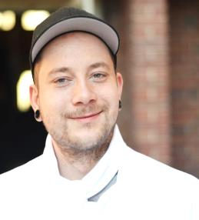
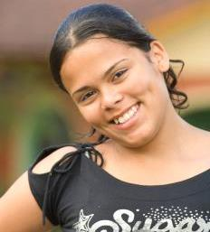
Global multi-stakeholder partnership
to strengthen youth employability
Notes:
Info on YouthCan! global partner(ships):
Allianz – In 2015, SOS Children’s Villages International joined global risk expert, insurance and financial services provider Allianz as international partner. After a successful first year, the partnership was extended to a period of another three years as of mid-2016.
The collaboration aims to empower young people to shape a secure future by building a resilient future generation that is able to overcome challenges and grasp opportunities to be fully integrated members of society.
In order to fulfil this vision, the partnership focusses on the following topics:
Safety and Preparedness
Youth Participation
Youth Development
AkzoNobel - AkzoNobel provides the opportunity for our young people to become ready for the job market and lead independent lives. The partnership mainly focuses on organizing painter trainings followed by a range of other activities jointly developed with AkzoNobel and SOS on local level, ensuring that the needs of the young people are met

Slide 9
19 YouthCan! Countries/ 9 for 2017 and 10 planned for 2018
Central Eastern Europe and CIS
Hungary and Czech Republic
Middle East & North Africa
Jordan
Morocco
Latin America & the Caribbean
Costa Rica
Brazil
Colombia
Argentina
Bolivia
Asia
Indonesia
India
Sri Lanka
Thailand
West and Central Africa
Cap Verde
East and South Africa
Nigeria
South Africa
Rwanda
Uganda
Madagascar
2017
2018
Notes:
Ignacio

