Slide 1
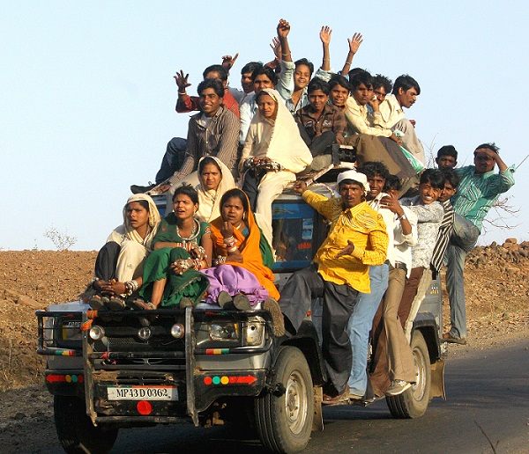
Interregional Youth Policy Forum 21-23 November 2017, Bangkok, UNCC
UNITED NATIONS
Sharing of project experience in ESCAP

Slide 2
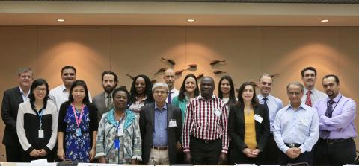
Development and early stages
Interregional Expert Group Meeting on Promoting Youth Development 11-12 November 2014

Slide 3
Training on Primary Data Collection for Youth Research Project 12-13 November 2014
Survey design and data collection
10,000 youth
Partners in:
Cambodia
India
Kyrgyzstan
Pakistan
Sri Lanka
Thailand

Slide 4
Partnerships

Slide 5
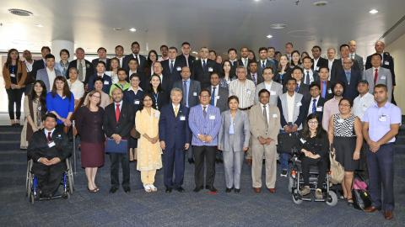
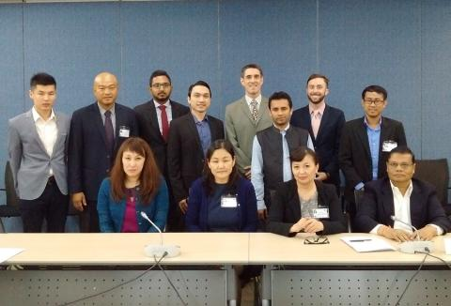
Committee on Social Development, Fourth Session
28 to 30 March 2016
Situation analysis presented
Asia-Pacific Workshop on Building Capacity to Develop Youth Policies
29 March 2016
Second situation analysis presented
3 focus countries for project confirmed:
Mongolia, Philippines, Sri Lanka

Slide 6
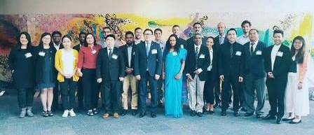
Asia-Pacific Workshop on Developing the Youth Policy Toolbox
15-16 November 2016
Letters of Agreement developed with partners

Slide 7
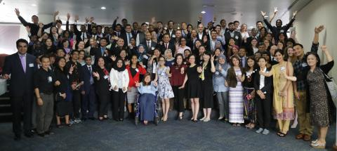
Workshop on Evidence-based Policies on Youth Development in Asia, and Workshop on Promoting the Sustainability of the Youth Policy Toolbox in Asia-Pacific 29 May - 1 June 2017

Slide 8
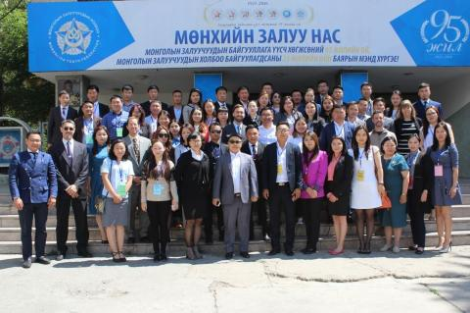
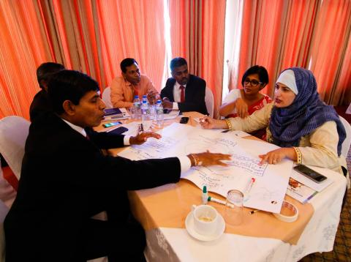
National Workshops to Test and Apply the Youth Policy Toolbox
Mongolia, 6-7 June 2017
Sri Lanka, 20-21 June 2017
Philippines, 28-29 June 2017

Slide 9
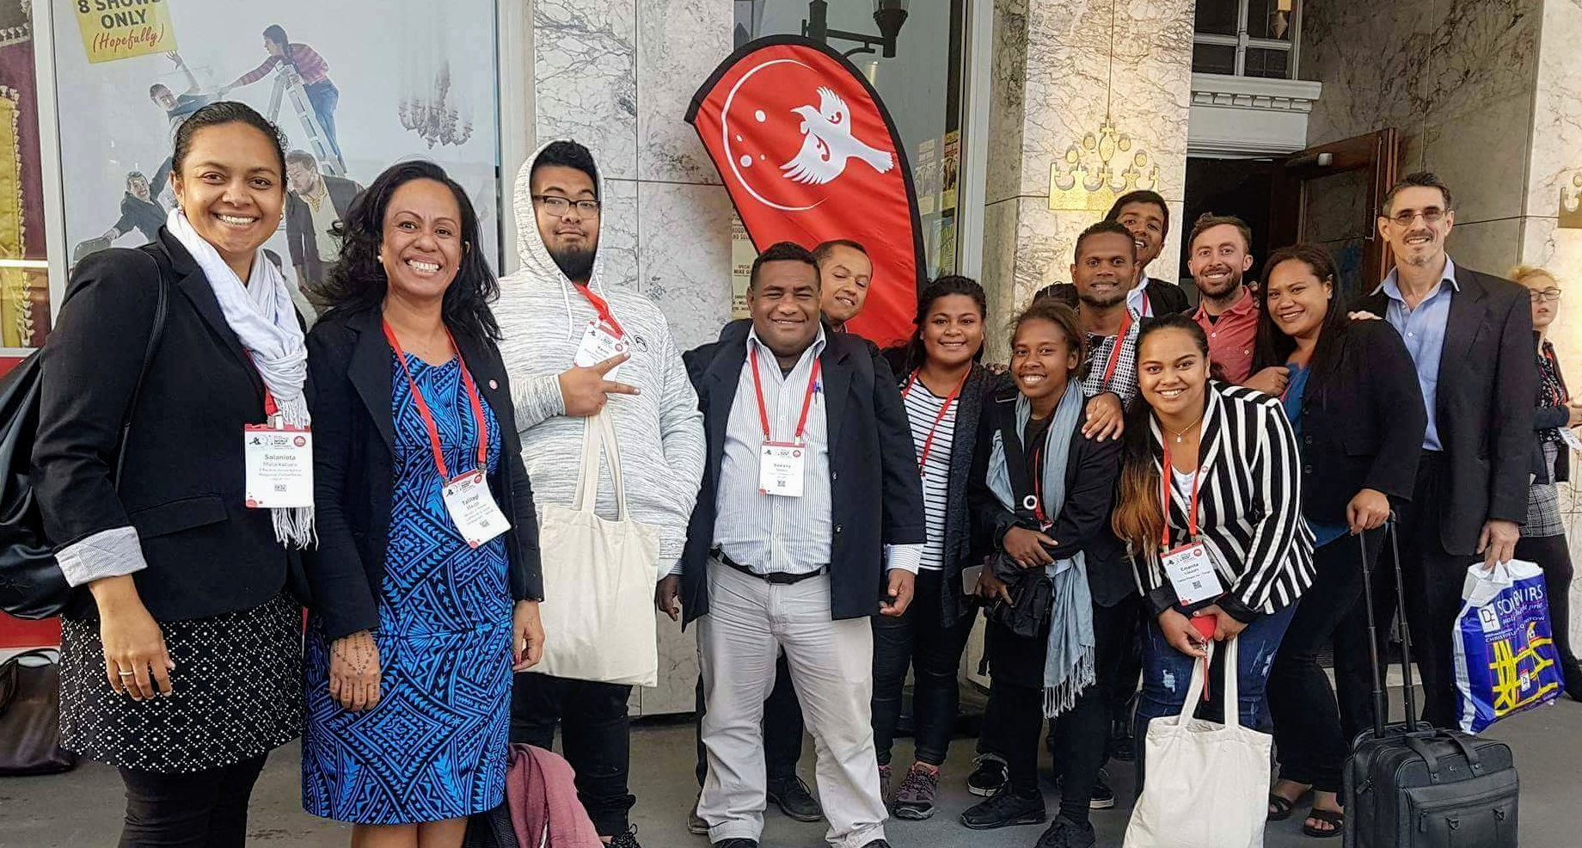
Pakistan Convention 3-4 November 2018
Pacific Consultations
26-29 September 2017

Slide 10
Notes:
https://youtu.be/CMMJ8prd88g

Slide 11
Lessons… Balance
Innovation ←→ Wisdom/ higher knowledge
Planning ←→ Flexibility
Health/longevity ←→ Hard work
Competition ←→ Collaboration/Teamwork
Non-violence, equity

