Slide 1
SHARING OF PROJECT EXPERIENCE
Challenges and Lesson learnt in the ECA Region
Mamusa Siyunyi
Social Affairs Officer, ECA

Slide 2
Implementation
“Strengthening the capacity of Governments in the ESCAP, ECA and ESCWA regions to respond to the needs of youth in formulating inclusive and sustainable development policies”
Partnership:
ECA, Population and Youth Section
Focus: Kenya, Mozambique & Sierra Leone
Youth organisations
Academics
AUC, UN agencies

Slide 3
Project
Regional analysis
Regional workshops
Toolbox
National workshops
Grants

Slide 4
FOCUS AREAS
Regional report
1
Education
2
Health
3
Political inclusion
4
Protection of rights and civic engagement
5
Employment and entrepreneurship
Situation analysis

Slide 5
Regional analysis: challenges and lessons
Data – disaggregated, current, politically acceptable
Covering 5 themes was ambitious
Data collection missions (Nigeria, Morocco & SA)
Key role of ministries of youth and UN country agencies
Establishing partnership with focus countries at this stage
Two regional consultants working in different countries
Internal ECA processes for publishing

Slide 6
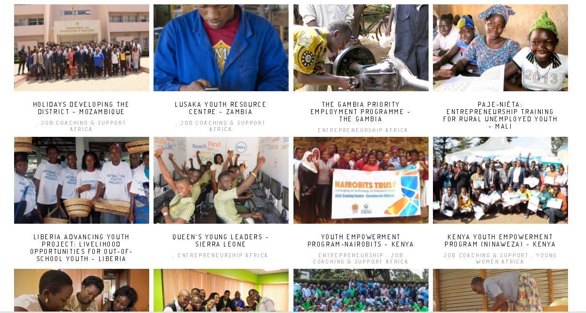
Preparation of the toolbox
Documenting school to work transition case studies (20)
Notes:
Documenting school to work transition case studies (20)
Regional consultants from academia
National youth experts/consultants
Regional youth organisations/grant recepients

Slide 7
Good practices focus
School-to-work transition
Entrepreneurship and employment
Youth who have dropped out of school
Technical and vocational training
Gender
Youth with disabilities
35 case studies

Slide 8
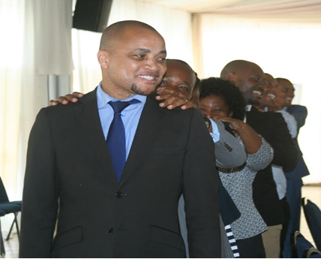
National workshops
Three workshops in focus countries – early 2017
Reviewed case studies
Introducing youth policy toolbox
Engagement of different youth actors
ECA visits to Youth ministries and initiatives

Slide 9
Grants to youth organisations
Regional youth organisations
PACSDA, YALDA and YMCA
Documenting case studies
Policy briefs and factsheets
Access and youth networks
Dissemination of the toolbox post project

Slide 10
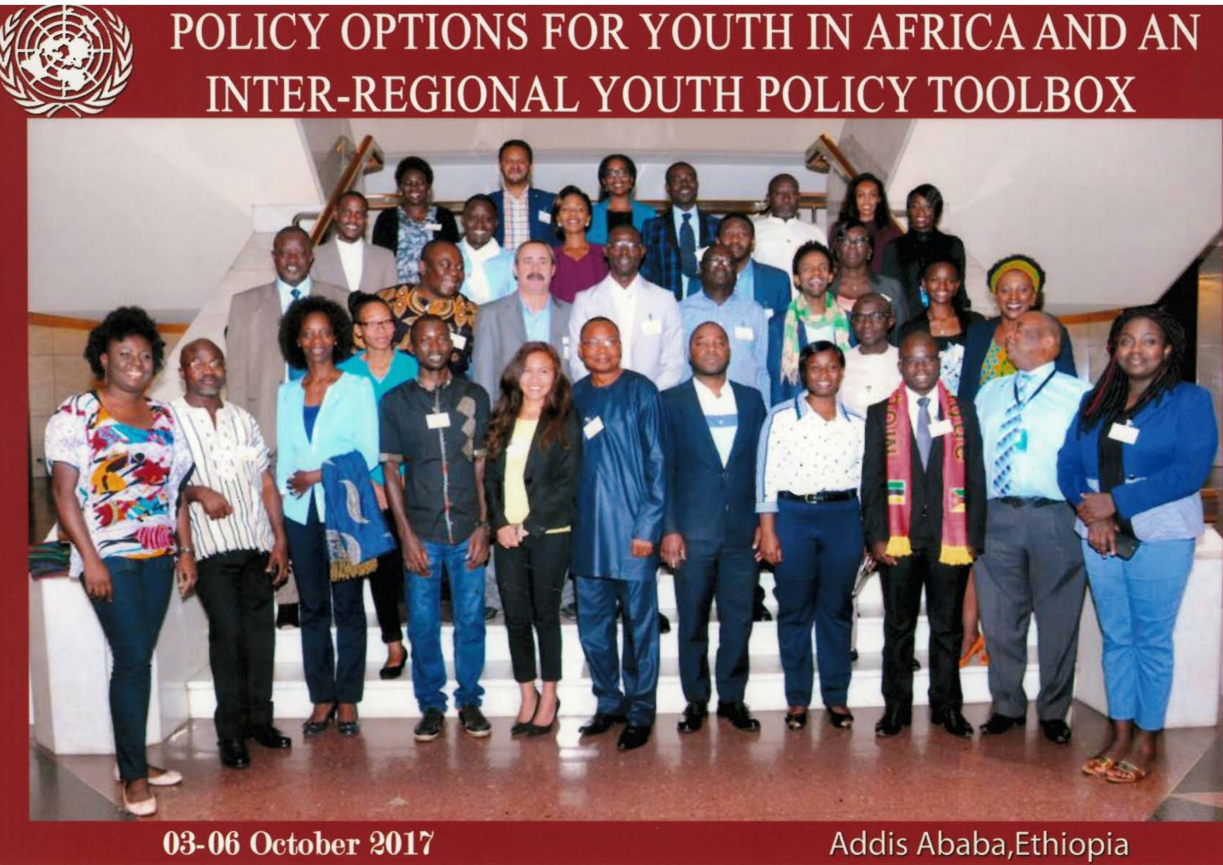
Regional workshop

Slide 11
Challenges and lessons
Policy environment in the focus countries
Ownership and engagement
Data and information in both ECA and member States
Disaggregated
Measuring results and impact of youth interventions
Documenting initiatives (audio and visual)
Reaching different groups of youth e.g. rural and disability
Identifying initiatives
Involvement throughout the project
Tapping into resources and expertise beyond the focus countries

Slide 12
Challenges and lessons cont’d
Internal to ECA
Transition into UMOJA + reorganisation of ECA
Staffing of PYS
Linking to other existing work e.g. on population and the DD
Linking Toolbox to ECA communication tools and standards
Partnership
AU, UN agencies, youth organisations
Using young people as consultants and resource persons
Language
ECA, ESCAP, ESCWA joined working
Value of sharing experiences across regions
Mix of activities
Design of DA projects and involving stakeholders during the process
Logistics for interregional workshop!

Slide 13
Thank you
Mamusa Siyunyi
Social Affairs Officer, ECA
Siyunyi@un.org

