Slide 1
THE YOUTH POLICY TOOLBOX – PAKISTANI PERSPECTIVE
Youth Forum
21- 23 Nov 2017
Bangkok-Thailand

Slide 2
TREADING THE UNTRODDEN PATH

Slide 3
LIST OF SUGGESTED TOPICS
Understanding the need of your customer
How to prepare for an interview
How to be a team member
Conflict resolution/Problem Solving
Meeting or exceeding the needs of your customer
Dealing with stress on job
Record keeping
Dealing with a difficult customer/employer
Communication skills : Process/Letter/Report writing
Time Management (selected)

Slide 4
Developing the Time Management Module

Slide 5
6 lessons
2-3 hours to go through them
Months to implement

Slide 6
The 9th National Convention on Students Quality Circles

Slide 7
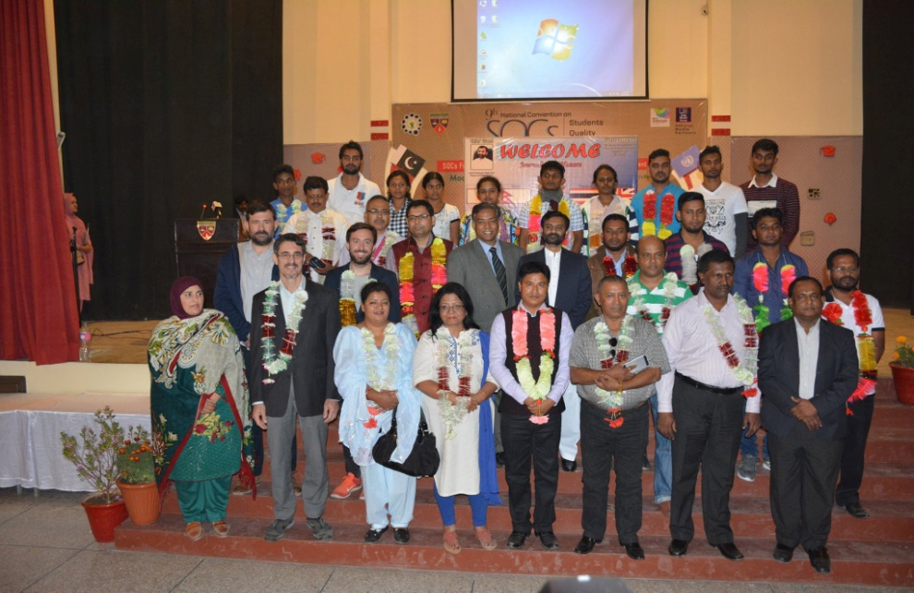
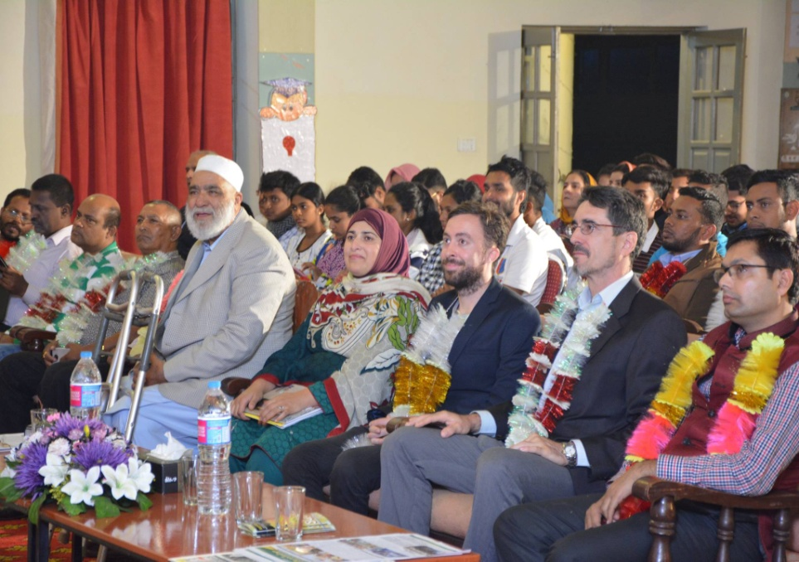

Slide 8
SHARING THE YOUTH POLICY TOOLBOX WITH YOUTH & EDUCATIONISTS

Slide 9
THOUGHT-PROVOKING DEBATES COMPETITION

Slide 10
SHARING THE TIME MANAGEMENT MODULE

Slide 12
GOOD BYE IS A NEW BEGINNING!!

