Slide 1
Interregional Youth Policy Forum 21-23 November 2017, Bangkok, UNCC
UNITED NATIONS
Introduction of agenda
objectives and expected outcomes

Slide 2
The Forum concludes a 2014-2017 interregional project
Title: Strengthening the capacity of Governments in the ESCAP, ECA and ESCWA regions to respond to the needs of youth in formulating inclusive and sustainable development policies
Objective:
To increase participation of youth in the formulation of inclusive and sustainable development policies in the regions

Slide 3
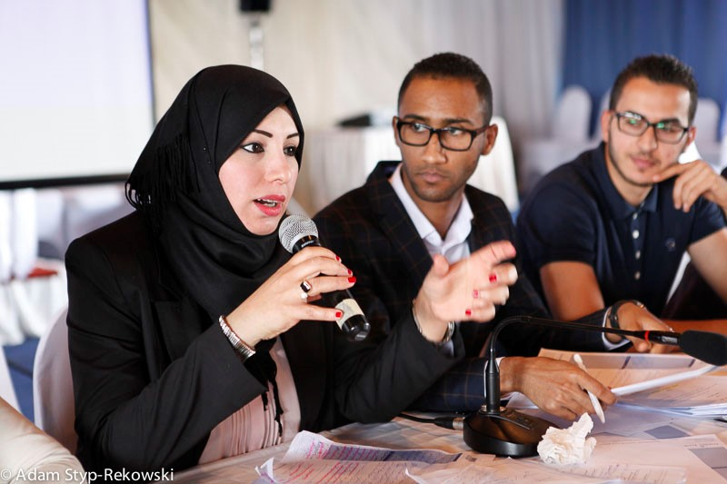
Forum Agenda, Day 1
House Rules
Respect
Phones silent
Punctuality/timing
Engagement
Opening
Panel: youth policy and development at global and regional levels
Panel: innovation and ICT in enhancing youth participation and the school-to-work transition
Feedback from project partners, learning from each other

Slide 4
Forum Agenda, Day 2
Feedback from project partners, learning from each other
Sharing of project experience in ECA, ESCAP and ESCWA
The Toolbox development journey

Slide 5
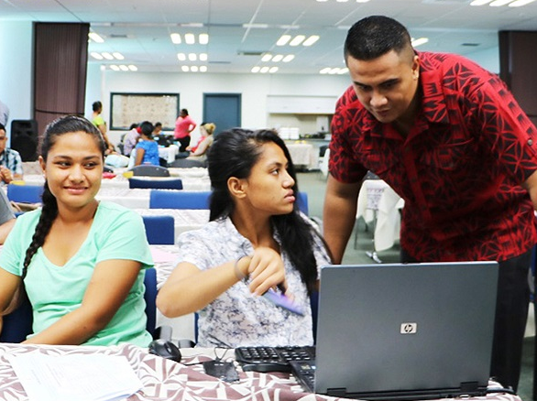
Forum Agenda, Day 3
Dissemination and development framework for the Youth Policy Toolbox
Closing
------------------
Evaluation meetings

Slide 6
Expected outcomes
Increased capacity to:
Develop Inclusive and responsive youth policies
Identify needs of youth and support their development
Use ICT and innovation to progress the youth agenda
Engage diverse stakeholders
Disseminate and sustain the Toolbox

Slide 7
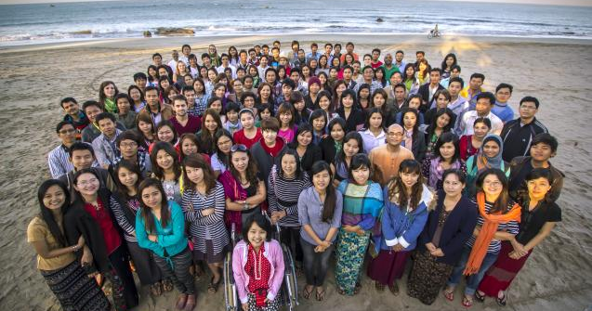
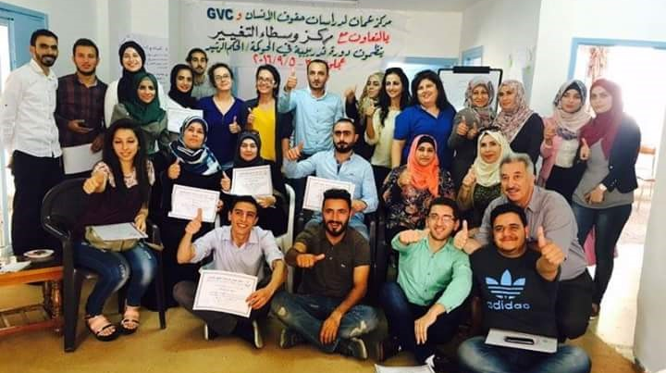
May we all have a very fruitful forum

