Slide 1
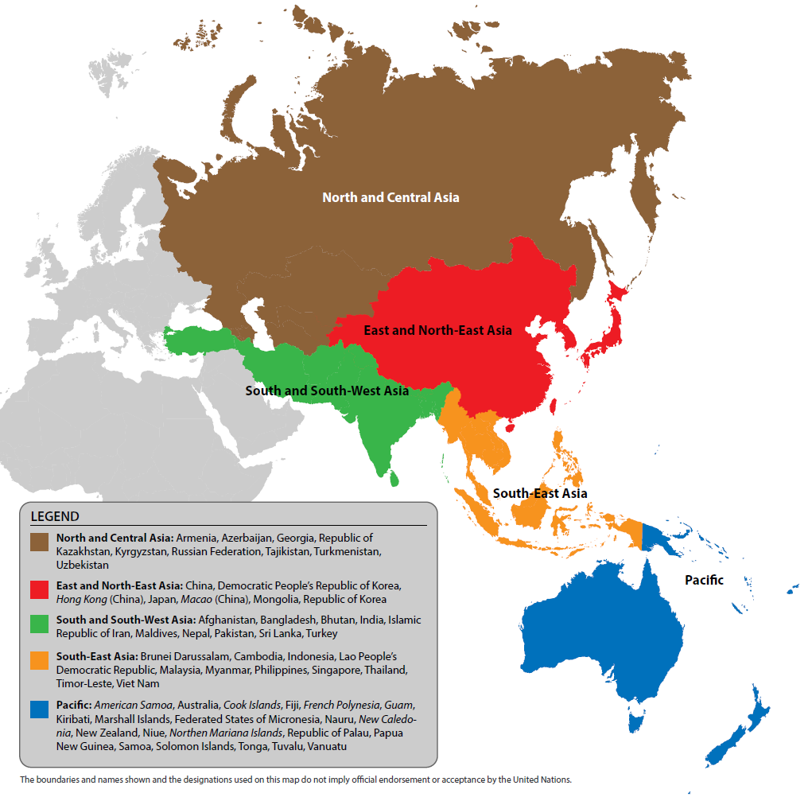
Asia and the Pacific

Slide 2
Ratio of female-to-male enrolment for tertiary education, Asia and the Pacific

Slide 3
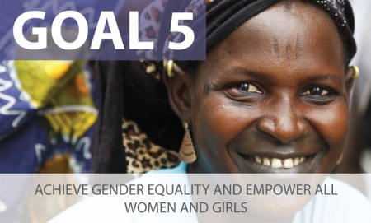
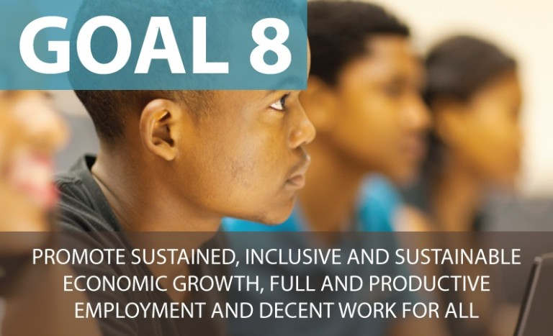
Youth Not in Education, Employment or Training
Source: ESCAP, Realizing Youth Inclusion for a More Sustainable Asia and the Pacific (forthcoming, late 2017)

Slide 4
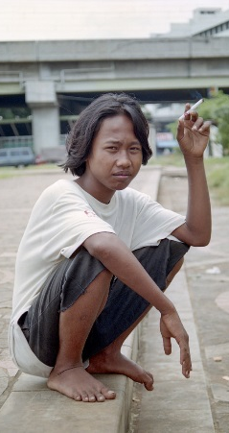
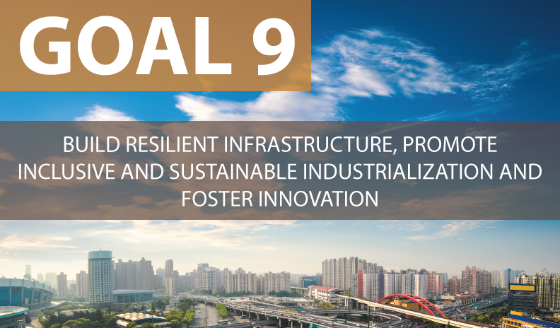
 | Internet use (%)
Country | Low Wealth | Med. Wealth | High Wealth
Cambodia | 40 | 62 | 82
Pakistan | 23 | 44 | 58
India | 61 | 64 | 82
Sri Lanka | 38 | 60 | 72
Thailand | 75 | 94 | 97
Kyrgyzstan | 69 | 75 | 79
Average | 32 | 69 | 81
Source: ESCAP, Realizing Youth Inclusion for a More Sustainable Asia and the Pacific (forthcoming, late 2017)

