Slide 1
Regional Youth Project on Leadership, Innovation and Entrepreneurship (Youth CoLab)
26 September 2017
Christchurch, New Zealand
Introducing ESCAP and the Youth Policy Toolbox
Bryce Hartley

Slide 2
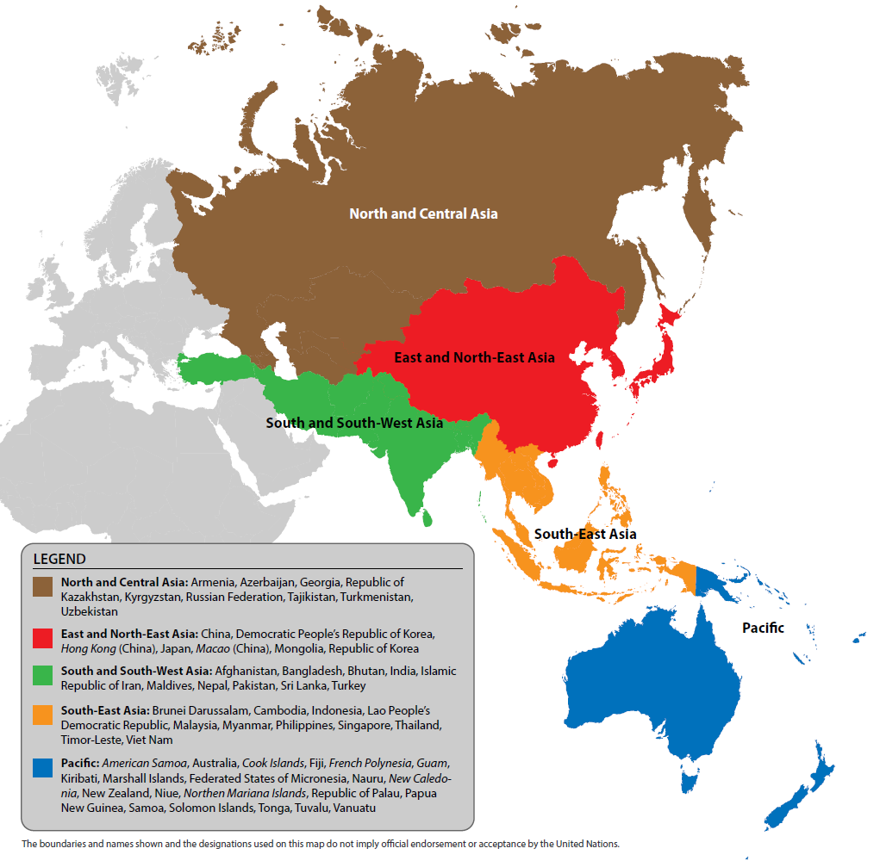
Notes:
Part of the United Nations Secretariat
Headquartered in New York City
António Guterres
Main office in Bangkok
Our work focus largely on intergovernmental cooperation within the domain of a large variety of substantive topics, for Marco and I, youth
Four subregions (Offices in New Delhi, Incheon, Almaty and Suva)
Three other similar commissions in Africa, Europe, Latin America and Western Asia

Slide 3
The 2030 Agenda
The Sustainable Development Goals: 17 global goals and 169 targets
Goal 4: Ensure inclusive and equitable quality education and promote lifelong learning opportunities for all
Goal 8: Promote sustained, inclusive and sustainable economic growth, full and productive employment and decent work for all
Notes:
The goals include:
Ending poverty and hunger
Improving health and education
Making cities more sustainable
Combating climate change
Protecting oceans and forests

Slide 4
The Sustainable Development Goals
Notes:
https://youtu.be/pBqe8JD62QE

Slide 5
ESCAP’s Youth Policy Toolbox
Drawing on the strength of ICT
Advocate for youth inclusive policies
Empower policymakers and youth
Connect
Stakeholder network
Surveys
Videos
Build capacity
Training modules
Good practices

Slide 6
Research Conducted
Initial research on school-to-work transitions
18 in-depth interviews with civil servants, policy consultants, and civil society
Mapping the user experience and synthesising

Slide 7
Policymakers
Address pain points of policymakers in their work
Provide tools and approaches that make it easier to be inclusive
Notes:
Help policymakers better understand what youth think and how to engage them
Sharing the opinions and ideas of young people
Publishing their questions
Videos
Survey results
Proven models of success
Good practices
Connecting policymakers with young people through our directory and feature good practices led by young people

Slide 8
Youth
Provide the information and tools they need
Enable them to engage in the discussion
Notes:
Understanding how to productively engage with the government
So that the energy of young people is channelled into positive change
This is very empowering because then young people become equal partners in generating change
Increase young people’s understanding of the concerns of government officials so as to foster stronger partnerships
By understanding the government’s perspective young people can position themselves better

Slide 9
Tailoring the Content
Showcase best practices for guidance
Identify useful tools for different stages of the process
Offer training to build capacity
Enable connections to experts/ youth
Notes:
After our initial design of the Toolbox we conducted national workshops in Mongolia, Sri Lanka, and the Philippines to better understand what young people and policymakers in the region think about such a platform and how it can be improved
From this feedback we’ve refined the Toolbox greatly but are always looking to make it better, which we hope we will with the help of everyone that’s here today.

Slide 10
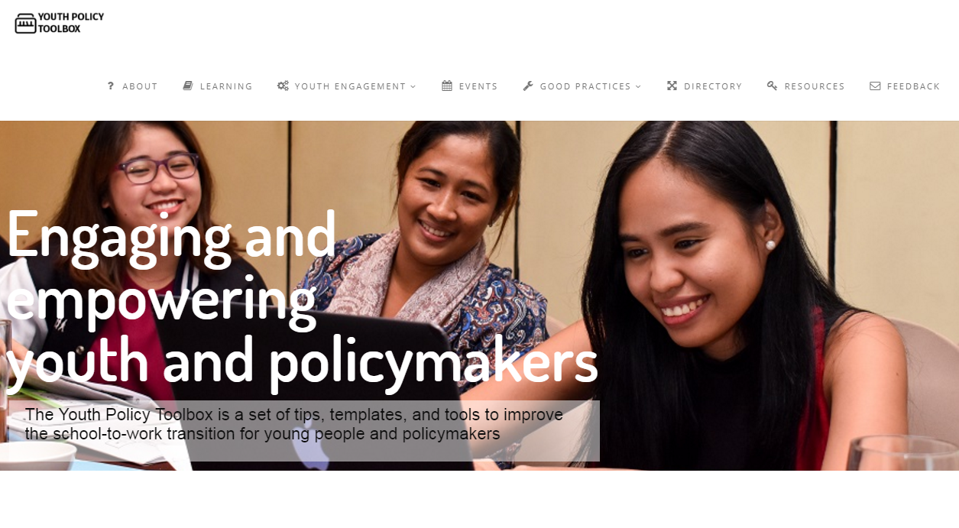

Slide 12
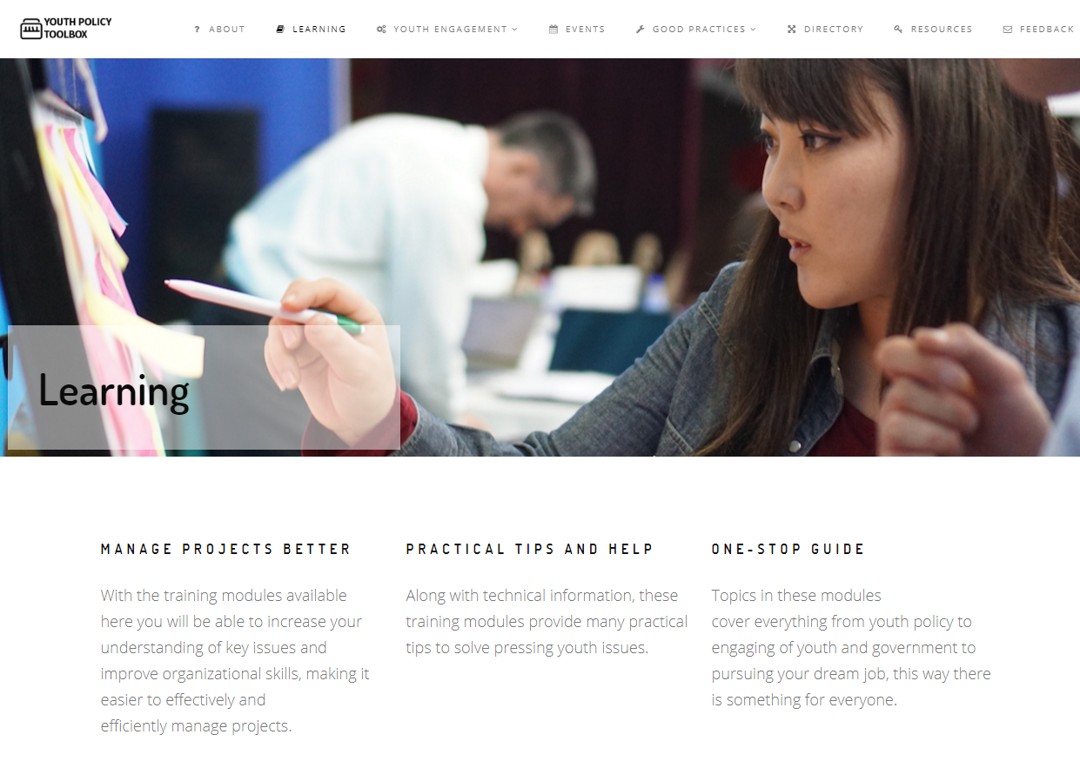

Slide 14
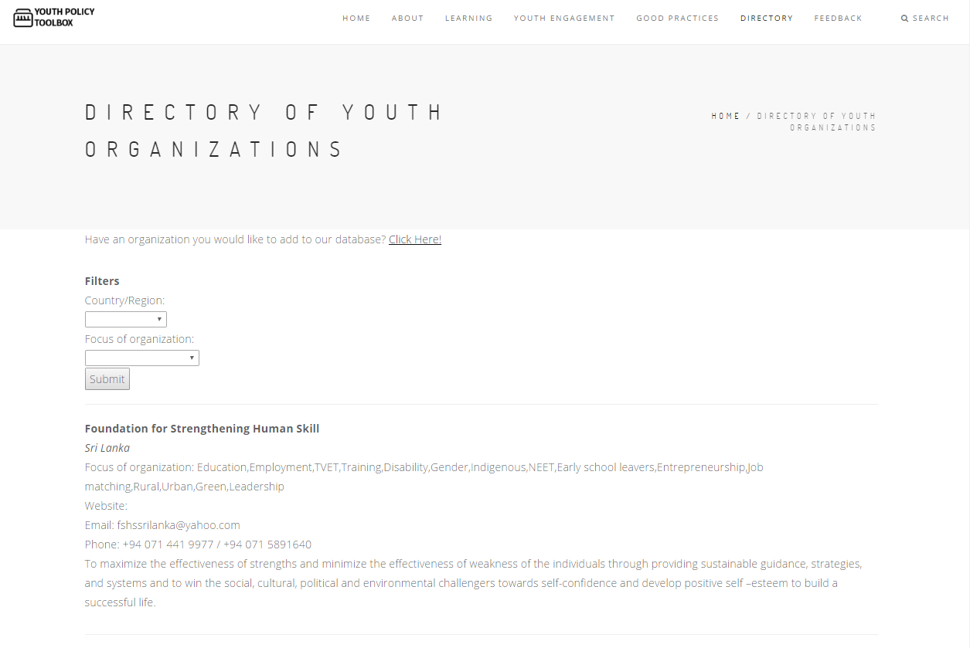

Slide 17
Thank you!

