Slide 1
Mongolia National Workshop to Test and Apply the Youth Policy Toolbox
6 June 2017
Ulaanbaatar, Mongolia
Introducing ESCAP and the Youth Policy Toolbox
Bryce Hartley

Slide 2
Introduction to UN ESCAP
The United Nations Economic and Social Commission on Asia and the Pacific
Main office in Bangkok
Four subregions (Offices in New Delhi, Incheon, Almaty and Suva)
Part of the United Nations Secretariat
Headquartered in New York City
António Guterres
Three other similar commissions
The Economic Commission on Africa (ECA)
The Economic Commission for Latin America (ECLA)
The Economic Commission for Western Asia (ECWA)

Slide 3
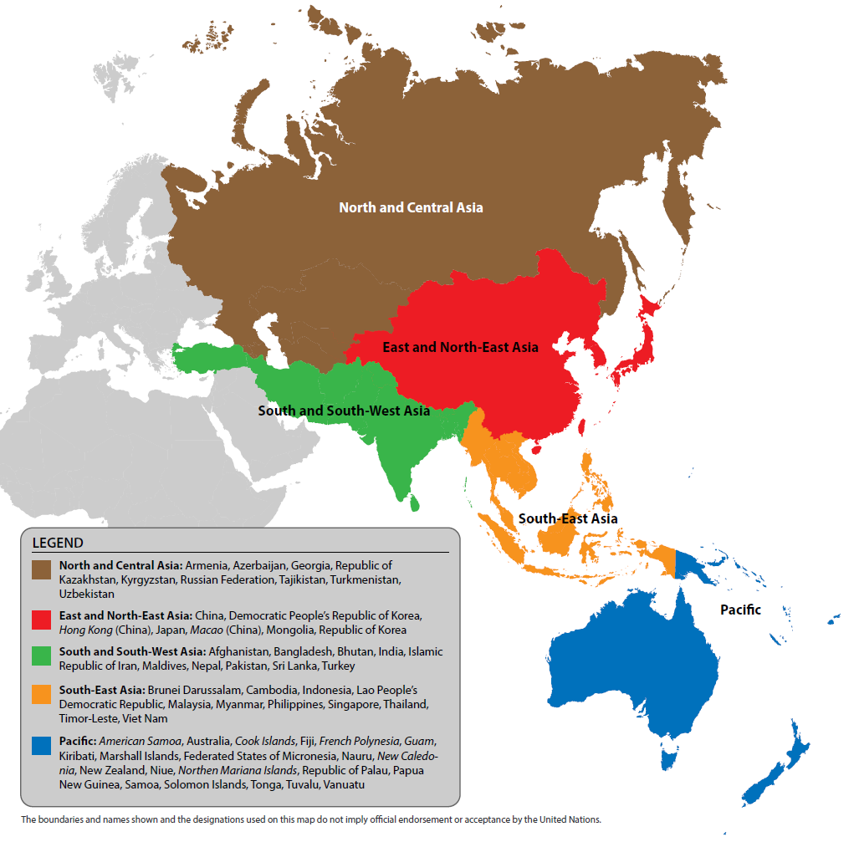

Slide 4
The 2030 Agenda
The Sustainable Development Goals: 17 global goals and 169 targets
The goals include
Ending poverty and hunger
Improving health and education
Making cities more sustainable
Combating climate change
Protecting oceans and forests
Goal 4: Ensure inclusive and equitable quality education and promote lifelong learning opportunities for all
Goal 8: Promote sustained, inclusive and sustainable economic growth, full and productive employment and decent work for all

Slide 5
The Sustainable Development Goals
Notes:
https://youtu.be/pBqe8JD62QE

Slide 6
ESCAP’s Youth Policy Toolbox
Drawing on the strength of ICT
Advocate for youth inclusive policies
Empower policymakers and youth
Connect
Sharing of good practices
Stakeholder network
Build capacity
Training modules

Slide 7
Research Conducted
Initial research on school-to-work transitions
18 in-depth interviews with civil servants, policy consultants, and civil society
Mapping the user experience and synthesising

Slide 8
Policymakers
Address pain points of policymakers in their work
Provide tools and approaches that make it easier to be inclusive

Slide 9
Youth
Provide the information and tools they need
Enable them to engage in the discussion

Slide 10
Tailoring the Content
Showcase best practices for guidance
Identify useful tools for different stages of the process
Offer training to build capacity
Enable connections to experts/ youth

Slide 12
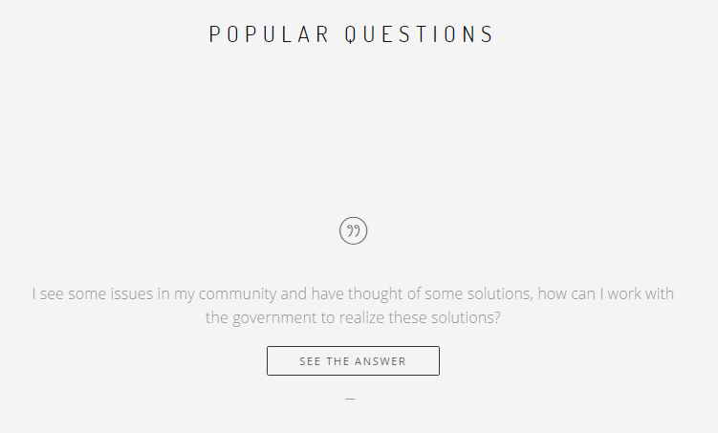

Slide 14
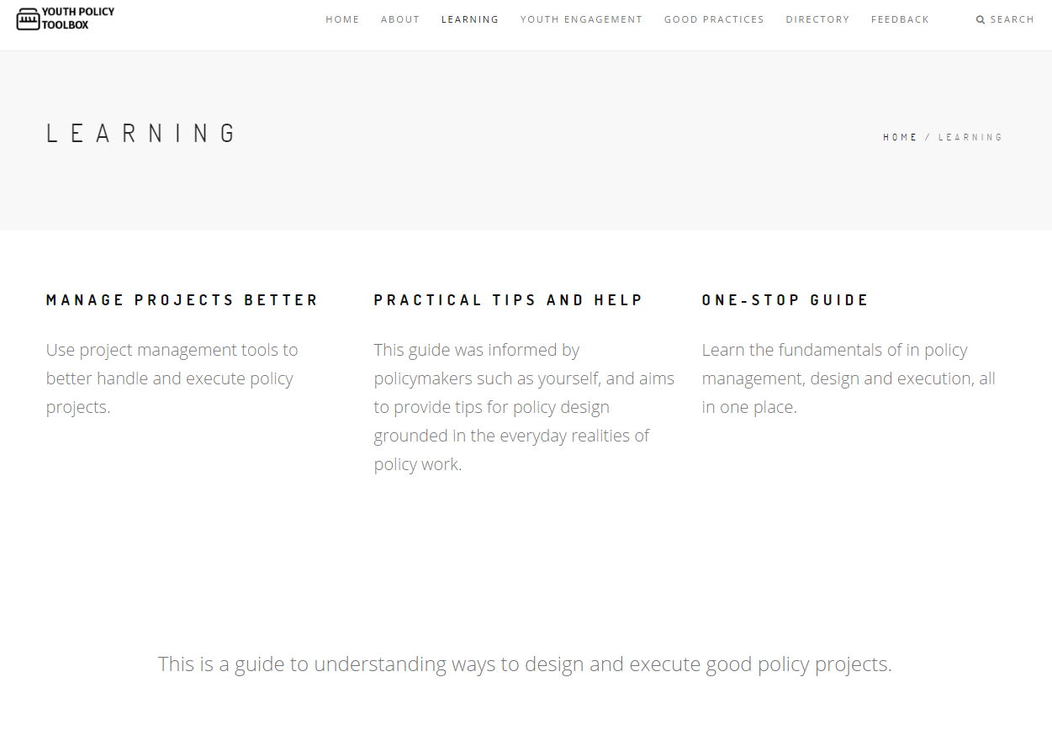

Slide 15
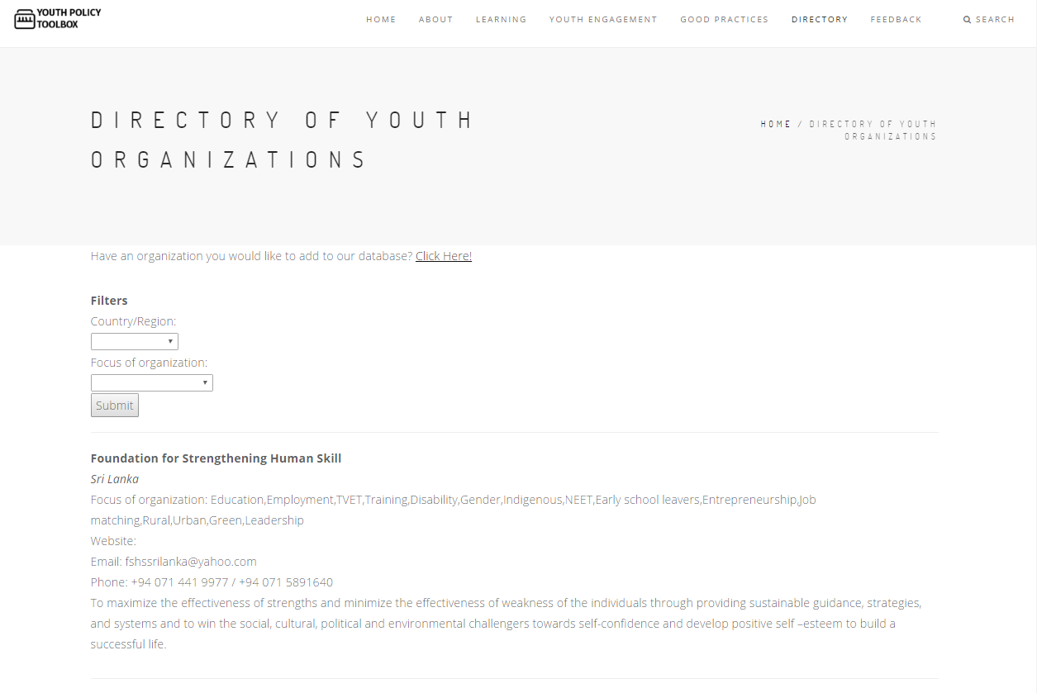

Slide 16
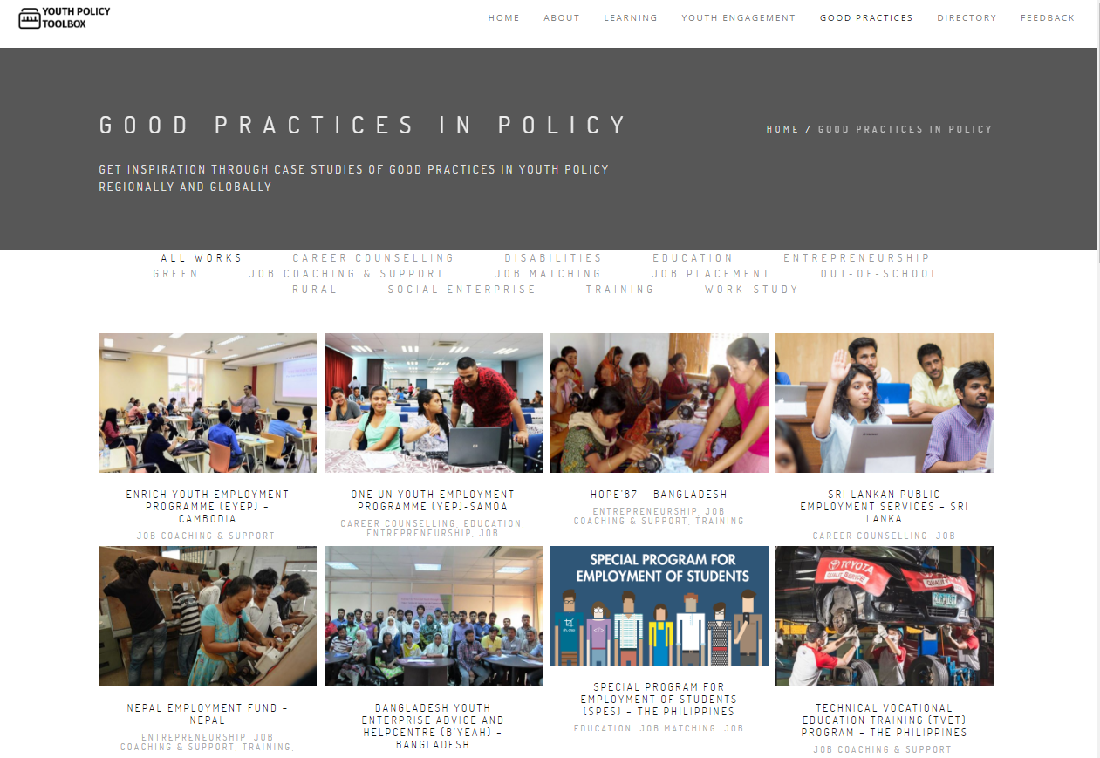

Slide 17
Thank you!

