Slide 1
YOUTH POLICY TOOLBOX
National Workshop to test and apply Youth Policy Toolbox
Sri Lanka
PRESENTATION ON EXPERIMENTS
Presents by – Wathsaridu Karunarathna

Slide 2
Key Challenges
After several discussions with senior government officials, policy makers and youth we identified that risky assumptions for the Policy toolbox in Sri Lankan are,
Youth in cities need to add a youth lens to the situational analysis of policy making
Policymakers undergo a traditional trajectory of policy making and they have less capacity
University students do not want to see good practices from other countries
Authorities experience a less coordination between institutions, departments and organizations

Slide 3
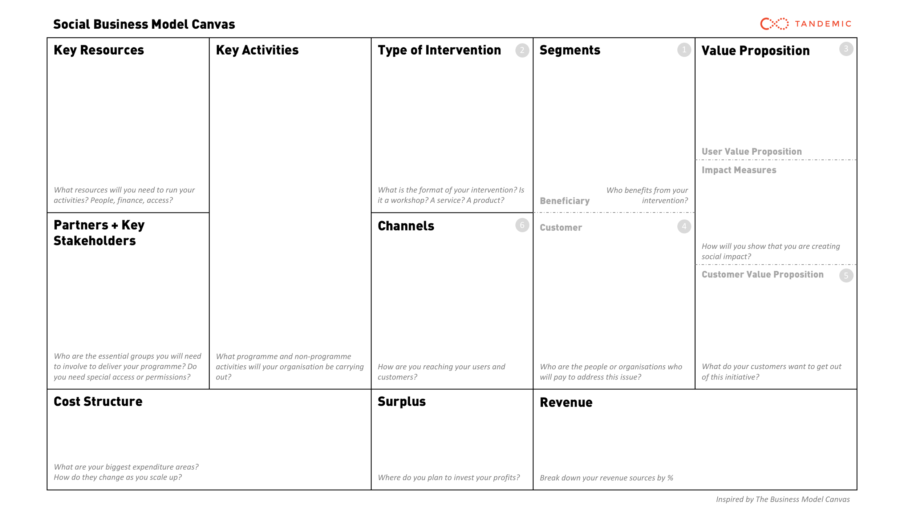
Keeping the website updated by sharing good practices, information and statistics
Toolbox with online training for policymakers and youth nonprofits and case examples of school-to-work transition programmes from other countries.
Youth in cities
Respective Policymakers in the Government Sector
eg -
1.Ministry of national Policy and Economic affairs
2.Open University of Sri lanka
2.Ministry of Statistics
3. National Youth services council
University Students
Vulnerable Youth groups
Youth in cities would be interested in seeing good practices from other countries in the school-to-work transition space
Policymakers can compare the local context with the international context
Children can find out opportunities they could pursue after school
Reach out to global opportunities
Partner with National Youth Services Council to reach out to youth
Reach Youth in Cities through Federation of Youth clubs
Reach policymakers through the Ministry of Youth
University Students through the respective associations/unions
National Youth Services Council
Ministry of national Policy and Economic affairs
Open University of Sri lanka
Sri lanka Federation of Youth Clubs
Sri lanka Youth Parliament
University Students Union

Slide 4
Experiments conducted so far
Youth in cities
Issue - integrating a youth lens to situation analysis
Solution - Consultations with youth on the challenges/ barriers/ weakness they experience in the policy making process
Government sector officials
Issue - Acquiring Capacity that meet the global demands of policy making
Solution - Organize an online training program for policy makers
University students
Issue - Decreased flow of information to university students about practices at the global level
Solution - Provide information on existing, upcoming opportunities, good practices on school to work transition, then interview about their relevance to them
experiment 1 (exploration)
experiment 2 (pitch)
experiment 3 (concierge)

Slide 5
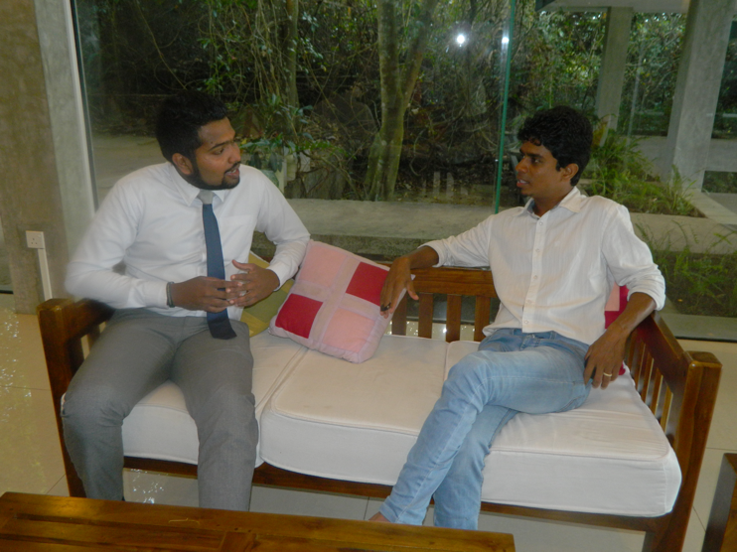
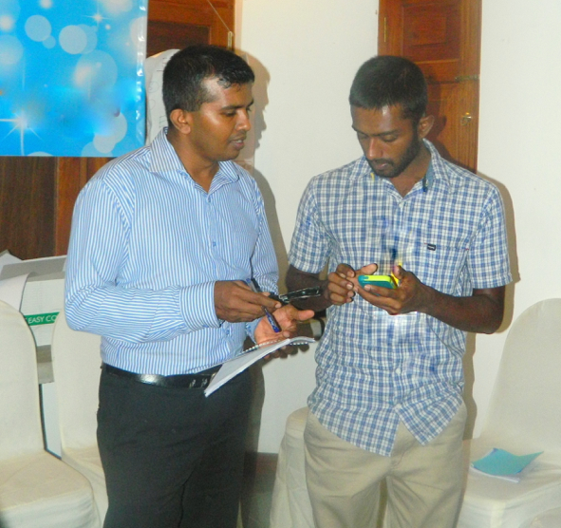
Experiment 1 - Youth in cities
Issue - integrating a youth lens to situation analysis
Solution - Consultations with youth on the challenges/ barriers/ weakness they experience in the policy making process
Test – Provide information on Youth policy toolbox statistics and data from the government departments and interview for their perspectives on the current policy making process in sri lanka

Slide 6
The respondents pointed out that
lack of career guidance and counselling opportunities in the context
No mechanism to measure and ensure decent jobs in the job market
Conflict between governments lead to lose their employment with the government change
No wide ranging consultation of youth and senior citizens – many youth voted on this
Over time, developed policies should be corrected or terminated if they turn out to be failures
Less knowledge on census, research and employment statistics
Having less experienced facilitators and resource people
Mismatch between the ideologies when we are going to implement
No transparency and credibility in the policy making cause the information is not shared with public

Slide 7
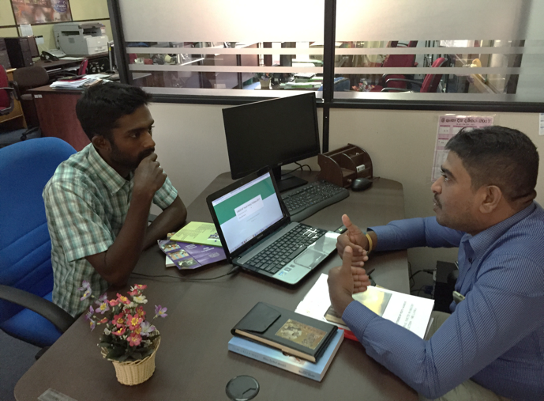
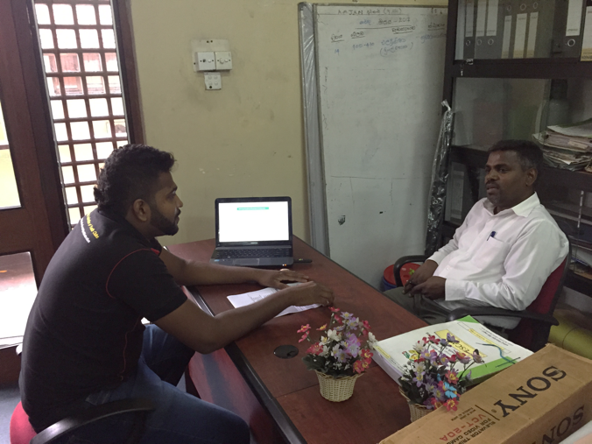
Experiment 2 - Government sector officials
Issue - Acquiring Capacity that meet the global demands of policy making
Solution - Organize an online training program for policy making
Test - Create marketing materials like handouts/sign up forms - Google forms and individually ask whether they believe that they need the international knowledge, experience about policy making??
Then ask are they willing to participate by paying $250 for the program?
Ask the same question for $100 and $50 - to measure the level of need**

Slide 8
The respondents pointed out that
100% agreed that Evidence based policies/approaches are productive
50% directly said that they do not have capacity to correlate with international demands and involve in policy making
80% signed up and said that they would like to participate in a training about youth policy and international demands
No one pointed out that it is a major issue but an issue to be concerned about.
10% said yes to pay $250
85% said yes to pay $100
5% said not paying either $250,$100 or $50
No higher educational opportunities/ awareness on public policy
No methodology to measure the success of the policy making process
Need more clear indicators and indices to statistically measure the present situation of unemployment/ underemployment

Slide 9
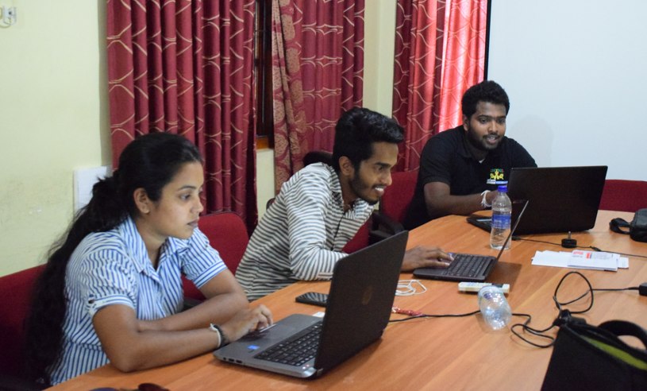
Experiment 3 – University Students
Issue - Decreased flow of information to university students about practices at the global level
Solution - Provide information on existing, upcoming opportunities, good practices on
school to work transition, then interview about their relevance to them
Test - Share Good practices with them and Asked them the things that we can adopt?
What are the barriers in sri lankan context if we wanted to implement such a good practice?

Slide 10
The respondents pointed out that
80% had stated that case studies could bring better outcomes if implemented in sri lanka (Mongolia – Youth labor exchange center/ Nepal – Employment fund)
Less career guidance opportunities
There is a need for a mechanism to ensure decent jobs
Communication,access to technology and cultural impact are barriers to find employment
No high level identification, endorsement and commitment to gear up
Completing professional qualifications that has a demand in the field is essential but competitive
Need to register unemployed youth through an online database

Slide 11
Challenges to run experiments
Language barrier
Access to internet and email is still at a critical state
Some partcipants were reluctant to read /reply for emails
Changing the traditional policymaking process is not an intention
Respondants were busy with their daily routines

Slide 12
Conclusion
1. Giving a youth lens to situational analysis of policy making is highlighted
2. There is a need of policymakers to undergo a capacity building in order to face the challenges in the real world policy making process
3. University students whom are entering into the world of work are interested to know case studies and good practices
4. Mainstreaming Youth in the policy making process is a must

Slide 13
THANK YOU

