Slide 1
YOUTH POLICY TOOLBOX PHILIPPINES
Experience and Experiments
June – October, 2017

Slide 2
Tools used
Calls: Local telephone or cellular phone
Shared files: Google Drive Folder
Instrument: Google Forms

Slide 3
Key risks
Local chief executives are not supportive of the Youth Toolbox
Local policymakers are not technically savvy
Local policymakers are supportive but not actually implementing the Youth Toolbox
Content of the Toolbox is not considered practical or localised by policymakers because it seems too different from their local context / difficult to localise success cases from outside the Philippines to local context
Content of the Toolbox is not considered practical or localised by youth leaders

Slide 4
Reasons why we think policy interventions fail
When policies go down to the grassroots level, certain adjustments have to be made so that they are locally relevant.
Some policies are viable in theory but not necessary in practice because people are not prepared.
There are not enough consultations at the local level. Policymakers are sometimes not attuned to recipients and to people’s everyday lives. Doing local consultations is expensive because of The Philippines’ geography.

Slide 5
Challenges to running experiments in The Philippines
Using Skype or video conference programs or applications especially among policymakers is very common
Many of the invited participants do not check their emails
Some participants are busy and are therefore not available for long phone calls, much more video conference calls
Time-constraint

Slide 6
 |  | 1 | 2 | 3 | 4 | 5 | 6 | 7
I think this user | Mothers within a 2-km radius | Local policymakers | Local policymakers | Local policymakers Youth leaders | Youth leaders | Youth leaders | Youth leaders | Youth leaders
Has this problem | Have trouble getting clean, safe drinking water | Finding approaches to improve school-to-work transition policies, if any | Learning about school-to-work transition policies | Not technically-savvy | Difficulty advocating for their ideas on school-to-work transition policies | Learning about school-to-work transition policies | Don’t have internet access to access the Toolbox | Don’t have internet access to access the policy toolbox
And this solution will solve it for them | Treatment centre selling 5 gallon per day water prepaid | Toolbox will provide insights on best practices | Online resource on school-to-work transition policies (Toolbox) | Online training on school-to-work transition policies (Toolbox) | Online training on advocacy and consultation with government officials | Online resource on school-to-work transition policies (Toolbox) | N/A | Access the Toolbox through a local policymaker’s office
The test I want to run is | Mothers can be convinced to switch from an existing source | Exploration - Interview policymakers to identify challenges in school-to-work transition policies and changes that they think need to be done to improve policies. | Concierge - Send a sample or demo of the Toolbox with best practices and provide a sign-up form to test if people are willing to use the Toolbox. Include in the form a short questionnaire to find out if the Toolbox is relevant in the local context and ask for their feedback. | Exploration - Find out if policymakers have experiences in learning or accessing resources online through webinars or databases, for example. | Pitch - Send an outline of the online training on youth engagement and consultation and provide signup form with listed prices to test how much they are willing to pay for the training. In the form, ask whether participants would be able to get sponsorship for the cost of the training. | Concierge - Send a sample or demo of the Toolbox with best practices and provide a sign-up form to test if people are willing to use the Toolbox. Include in the form a short questionnaire to find out if the Toolbox is relevant in the local context and ask for their feedback. | Exploration - Interview youth leaders to find out what may hinder them from accessing the Toolbox. Ask them whether they have a sufficiently good internet connection to watch Youtube videos. | Pitch - Ask policymakers if they would be willing to make a computer with stable internet connection in their office available. They will host interested youth to facilitate their learning through the Toolbox.
I will consider this test successful if | Pitch 7/10 is a success | Exploration 6/10 | Concierge 6/10 | Exploration 6/10 | Pitch 6/10 | Concierge 6/10 | Exploration 6/10 | Pitch 6/10

Slide 7
Experiment 1
We want to know if – local policymakers
Have the problem – finding approaches to improve school-to-work transition policies, if any
So we ran the experiment – interviewed policymakers to identify challenges in school-to-work transition policies and changes that they think need to be done to improve policies.

Slide 8
Experiment 1
60% respondents answered No when asked if they have existing school-to-work transition policies
Those who answered Yes identified the following policies and programs:
PESO
On-the-job Training
Internships

Slide 9
Experiment 1
When asked about the challenges they encounter in formulating and implementing school-to-work transition policies, they answered:
More focus on infrastructure rather than skills and human development
Focus on livelihood mostly cater to those aged 35 and above
Lack of networking between the government and private groups
Courses of students are not inclined and directly compatible with the workplace’s objectives and work ethics
Matching career choices of students with the country’s manpower needs
Knowledge transition of legislative and legal processes unique to the policymaker
Natural volatility of the market

Slide 10
Experiment 2
We want to know if – local policymakers
Have the problem – learning about school-to-work transition policies
So we ran the experiment – Sent a sample or demo of the Toolbox with best practices and provide a sign-up form to test if people are willing to use the Toolbox. Include in the form a short questionnaire to find out if the Toolbox is relevant in the local context and ask for their feedback

Slide 11
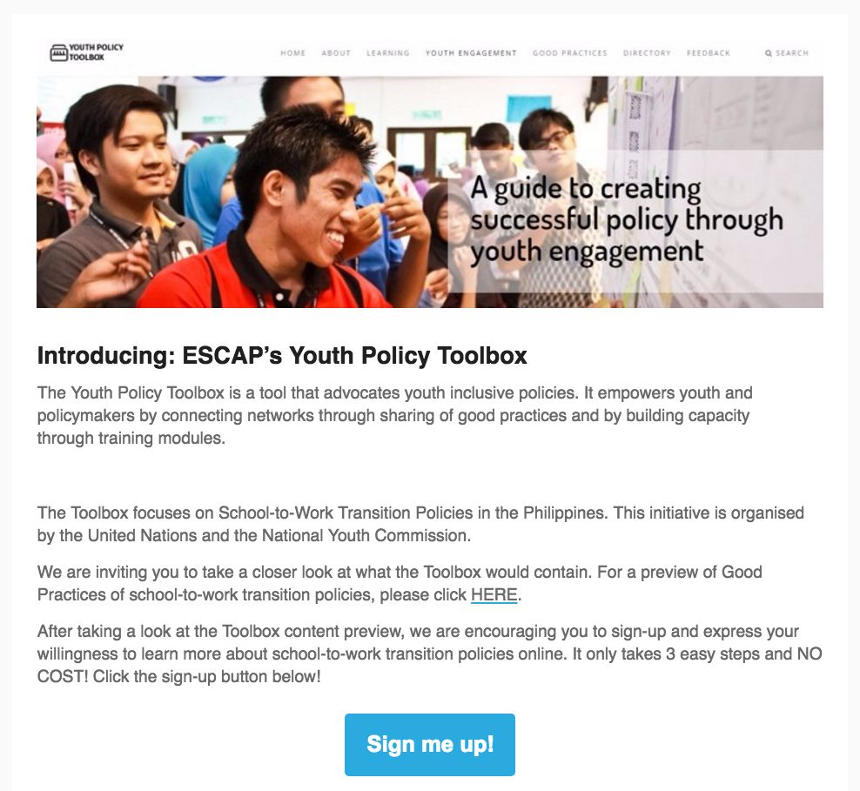
Experiment 2
All respondents said that the Toolbox will help them learn more about school-to-work transition policies
“We welcome any additional knowledge or training that we can access so it can guide us into making legislation that will help our people.”
1/2 policymakers responded to the sign-up form

Slide 12
Experiment 3
We want to know if – local policymakers and youth leaders
Have the problem – not technically-savvy
So we ran the experiment – found out if they have experiences in learning or accessing resources online through webinars or databases, for example

Slide 13
Experiment 3
20/20 respondents have used the internet to learn
WiFi, mobile data
Massive open online course (MOOC), Google, news, social media
Laptop, desktop, cellular phone

Slide 14
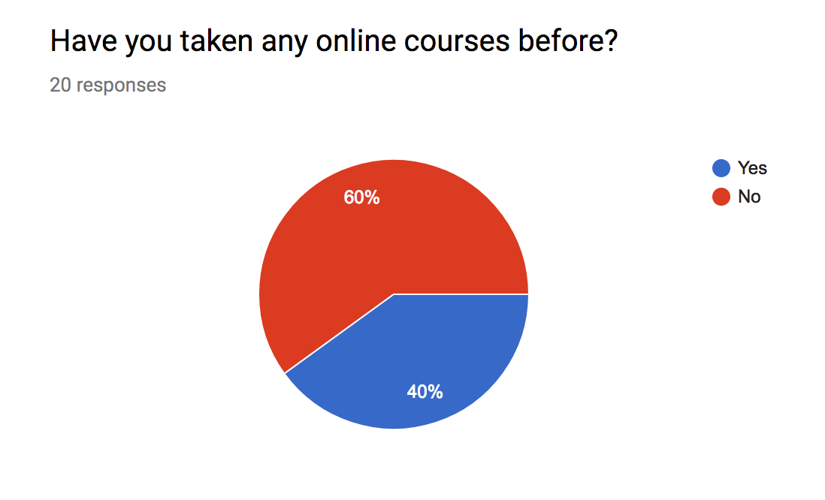
Experiment 3
Experiences:
Useful
Accessible
Convenient
Doubts on legitimacy
Challenging because of time-difference
Pacing is unpredictable
A bit boring but helpful
Promote self-paced studying

Slide 15
Experiment 3

Slide 16
Experiment 3
We asked them why they chose to learn through the internet
Convenient
Easy to access
Accurate
Time-saving
More efficient

Slide 17
Experiment 4
We want to know if – youth leaders
Have the problem – difficulty advocating for their ideas on school-to-work transition policies
So we ran the experiment – sent an outline of the online training on youth engagement and consultation and provide signup form with listed prices to test how much they are willing to pay for the training. In the form, ask whether participants would be able to get sponsorship for the cost of the training.

Slide 18
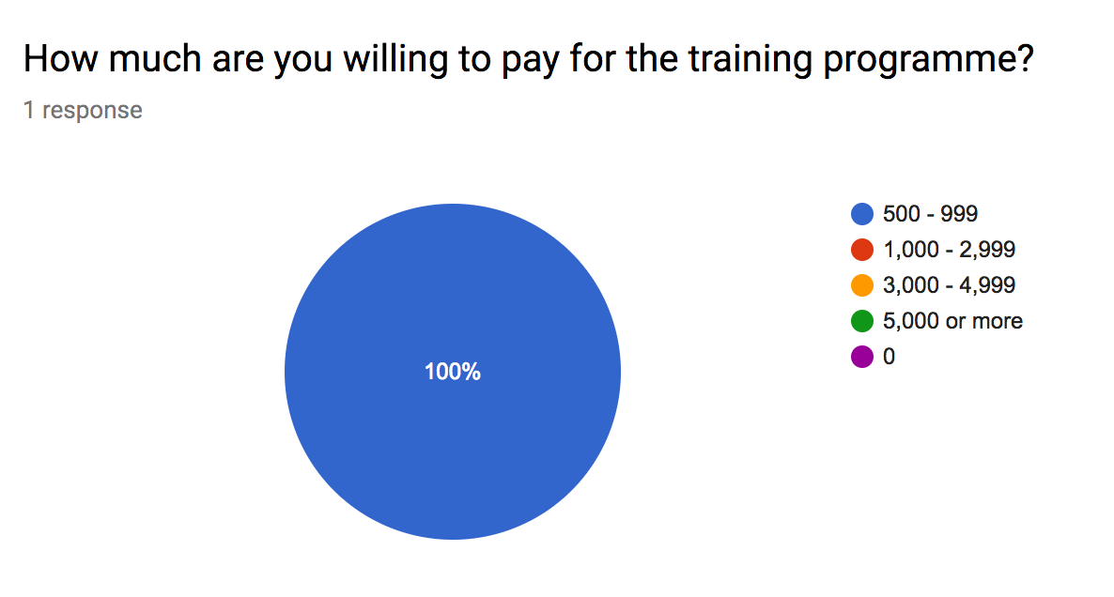
Experiment 4
Only 1/7 signed up and is willing to pay only Php500-999 for the training programme

Slide 19
Experiment 5
We want to know if – youth leaders
Have the problem – learning about school-to-work transition policies
So we ran the experiment – find out if the Toolbox is relevant in the local context and ask for their feedback

Slide 20
Experiment 5
10/10 said that Toolbox is relevant in their locality

Slide 21
Experiment 6
We want to know if – youth leaders
Have the problem – don’t have internet access to access the Toolbox
So we ran the experiment – interviewed youth leaders to find out what may hinder them from accessing the Toolbox. Ask them whether they have a sufficiently good internet connection to watch Youtube videos.

Slide 22
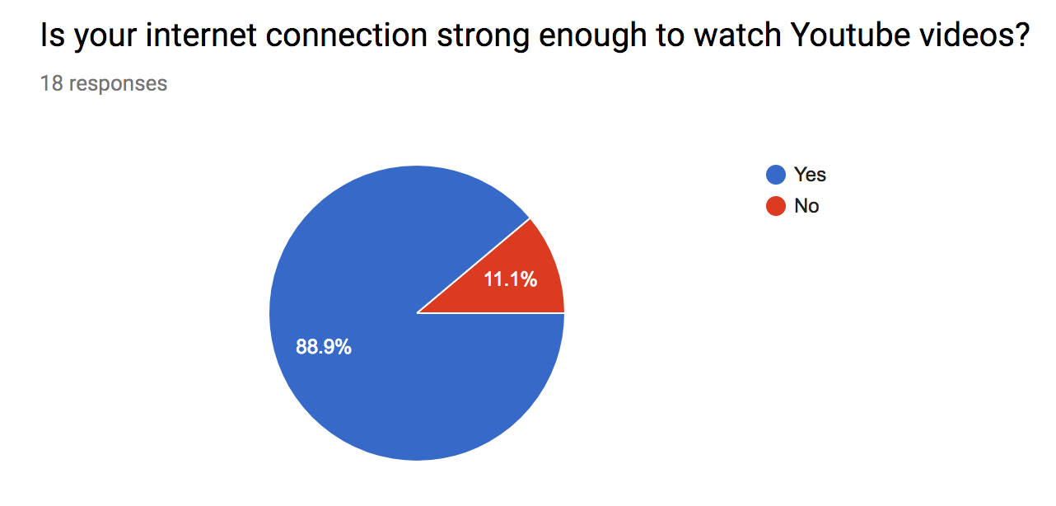
Experiment 6

Slide 23
Experiment 7
We want to know if – youth leaders
Have the problem – don’t have internet access to access the Toolbox
So we ran the experiment – asked policymakers if they would be willing to make a computer with stable internet connection in their office available. They will host interested youth to facilitate their learning through the Toolbox

Slide 24
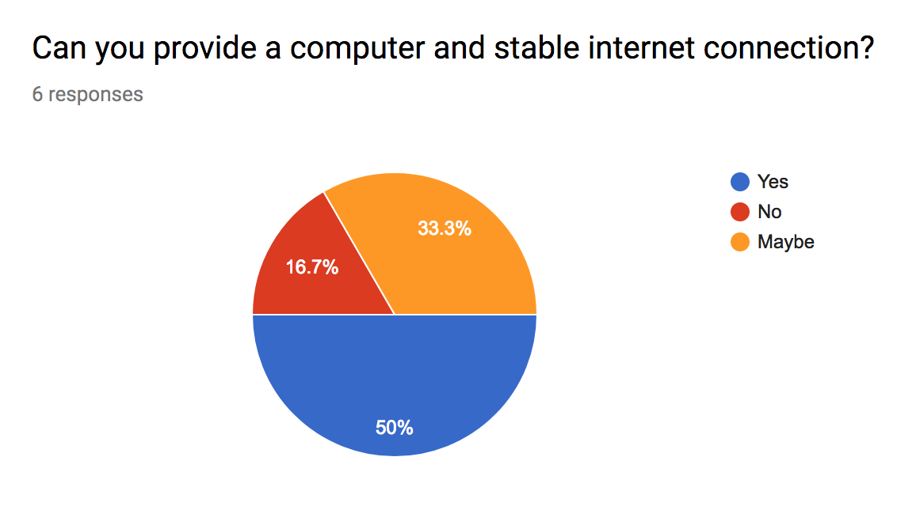
Experiment 7
Only 60% said they are willing to host and not all of them can provide a computer and internet connection

Slide 25
THANK YOU!
Johanna Ella May Erroba
Youth Policy Toolbox Technical Staff

